Slide 1
CanSat 2023 Preliminary Design Review (PDR) Outline Version 1.0
Team 1032
Yes we CANSAT

Slide 2

Presentation Outline
Page #​ | Presentation Section​ | Presenter(s)​
5​ | Systems Overview​ | Savari Datta, Jordi Rey, Daniel Horton
20 | Sensor Subsystem Design​ | Dylan Falzone
30 | Descent Control Design​ | Jovana Markovic, Melissa Gonzalez Grospe
40 | Mechanical Subsystem Design​ | Daniel Horton, Christian Roque, Savari Datta, Melissa Gonzalez Grospe
55 | Communication and Data Handling (CDH) Subsystem Design​ | Yashas Shivaram, Max Epstein
65 | Electrical Power Subsystem (EPS) Design​ | Paolo D’Alessandro
70 | Flight Software (FSW) Design​ | Max Epstein
80 | Ground Control System (GCS) Design​ | Dylan Falzone, Max Epstein
87 | CanSat Integration and Test​ | Jordi Rey, Yashas Shivaram
95 | Mission Operations & Analysis​ | Jordi Rey​
100 | Requirements Compliance​ | Savari Datta​
108 | Management​ | Savari Datta
Presenter: Savari Datta

Slide 3
Team Organization
Faculty Advisor
Ting Dong
Team Lead
Savari Datta
Junior
Container Subsystem
Payload & Aerodynamics
Payload Deployment
Avionics Subsystem
Flight Software
Container
Christian Roque
Freshman
Payload Lead
Jordi Rey
Junior
Aerodynamics Lead
Jovana Markovic Junior
Avionics Lead
Dylan Falzone
Junior
Flight Software
Max Epstein
Sophomore
Daniel Horton
Junior
Yashas Shivaram Junior
Melissa Gonzalez Grospe
Sophomore
Paolo D’Alessandro
Junior
Presenter: Savari Datta

Slide 4
Acronyms
Acronym | Meaning
ABS | Acrylonitrile Butadiene Styrene
CD | Drag Coefficient
CDH | Communication and Data Handling
CSV | Comma-Separated Values
DAC | Digital-to-Analog Converter
EPS | Electrical Power Subsystem
FSW | Flight Software
GCS | Ground Control System
GPS | Global Positioning System
IDE | Integrated Development Environment
LED | Light-Emitting Diode
MAE | Mechanical & Aerospace Engineering
Acronym | Meaning
MQTT | MQ Telemetry Transport
OTS | Off-the-shelf
PDR | Preliminary Design Review
PID | Proportional-Integral-Derivative
PWM | Pulse-Width Modulation
RPM | Revolutions per Minute
SMA | Subminiature Version A
SPI | Serial Peripheral Interface
SSDC | Space Systems Design Club
STEM | Science, Technology, Engineering, and Mathematics
UF | University of Florida
Presenter: Savari Datta

Slide 5
Systems Overview
Savari Datta, Jordi Rey, Daniel Horton

Slide 6
Mission Summary (1/2)
Main Objectives:​
Design a CanSat that shall consist of a container and a payload. The probe shall simulate the sequence of a planetary probe
​
The CanSat shall be launched to an altitude ranging from 670 meters to 725 meters above the launch site and deployed near apogee (peak altitude).
The CanSat must survive the forces incurred at launch and deployment.
Once the CanSat is deployed from the rocket, the CanSat shall descend using a parachute at a rate of 15 m/s.
At 500 meters, the CanSat shall deploy a probe that shall open a heat shield.
The heat shield will be used as an aerobraking device with a descent rate of 20 meters/second or less.
When the probe reaches 200 meters, the probe shall deploy a parachute and slow the descent rate to 5 meters/second.
Once the probe has landed, it shall attempt to upright itself and raise a flag 500 mm above the base of the probe.
The video camera shall be pointed towards the ground during descent.
Presenter: Savari Datta

Slide 7
Mission Summary (2/2)
Bonus Objectives:​
A video camera shall be integrated into the container and point toward the probe. The camera shall record the event when the probe is released from the container. Video shall be in color with a minimum resolution of 640x480 pixels and a minimum of 30 frames per second.
Will not be attempting bonus objective
External Objectives:​
To promote STEM engagement at the university level
To provide team members with valuable hands-on engineering project experience that includes designing, manufacturing and testing of an aerospace system
To challenge students with unique projects that require critical thinking
To inspire underclassmen to continue participating in the annual CanSat competition at UF
Presenter: Savari Datta

Slide 8
System Requirement Summary (1/6)
Requirement Number​ | Description​
1​ | Total mass of the CanSat (science payloads and container) shall be 700 grams +/- 10 grams.
2​ | CanSat shall fit in a cylindrical envelope of 125 mm diameter x 400 mm length. Tolerances are to be included to facilitate container deployment from the rocket fairing.
3​ | The container shall not have any sharp edges to cause it to get stuck in the rocket payload section which is made of cardboard.
4​ | The container shall be a fluorescent color; pink, red or orange.
5​ | The container shall be solid and fully enclose the science probes. Small holes to allow access to turn on the science probes are allowed. The end of the container where the probe deploys may be open.
6​ | The rocket airframe shall not be used to restrain any deployable parts of the CanSat.
7​ | The rocket airframe shall not be used as part of the CanSat operations.
8​ | The container’s parachute shall not be enclosed in the container structure. It shall be external and attached to the container so that it opens immediately when deployed from the rocket.
9​ | The Parachutes shall be fluorescent Pink or Orange
10​ | The descent rate of the CanSat (container and science probe) shall be 15 meters/second +/- 5m/s.
11​ | 0 altitude reference shall be at the launch pad.
Presenter: Savari Datta

Slide 9
System Requirement Summary (2/6)
Requirement Number​ | Description​
12 | All structures shall be built to survive 15 Gs of launch acceleration.
13 | All structures shall be built to survive 30 Gs of shock
14 | All electronics and mechanical components shall be hard mounted using proper mounts such as standoffs, screws, or high-performance adhesives.
15 | All mechanisms shall be capable of maintaining their configuration or states under all forces.
16 | Mechanisms shall not use pyrotechnics or chemicals.
17 | Mechanisms that use heat (e.g., nichrome wire) shall not be exposed to the outside environment to reduce potential risk of setting vegetation on fire.
18 | Both the container and payload shall be labeled with team contact information including email address.
19 | Cost of the CanSat shall be under $1000. Ground support and analysis tools are not included in the cost. Equipment from previous years should be included in this cost, based on current market value.
20 | XBEE radios shall be used for telemetry. 2.4 GHz Series radios are allowed. 900 MHz XBEE radios are also allowed.
21 | XBEE radios shall have their NETID/PANID set to their team number.
22 | XBEE radios shall not use broadcast mode.
23 | The container and probe shall include an easily accessible power switch that can be accessed without disassembling the CanSat and science probes and in the stowed configuration.
Presenter: Savari Datta

Slide 10
System Requirement Summary (3/6)
Requirement Number​ | Description​
24 | The probe shall include a power indicator such as an LED or sound generating device that can be easily seen or heard without disassembling the CanSat and in the stowed state.
25 | An audio beacon is required for the probe. It shall be powered after landing.
26 | The audio beacon shall have a minimum sound pressure level of 92 dB, unobstructed.
27 | Battery source may be alkaline, Ni-Cad, Ni-MH or Lithium. Lithium polymer batteries are not allowed. Lithium cells must be manufactured with a metal package similar to 18650 cells. Coin cells are allowed.
28 | An easily accessible battery compartment shall be included allowing batteries to be installed or removed in less than a minute and not require a total disassembly of the CanSat.
29 | Spring contacts shall not be used for making electrical connections to batteries. Shock forces can cause momentary disconnects.
30 | The CanSat shall operate during the environmental tests laid out in Section 3.5.
31 | The CanSat shall operate for a minimum of two hours when integrated into the rocket.
32 | The probe shall be released from the container when the CanSat reaches 500 meters.
33 | The probe shall deploy a heat shield after leaving the container.
34 | The heat shield shall be used as an aerobrake and limit the descent rate to 20 m/s or less.
35 | At 200 meters, the probe shall release a parachute to reduce the descent rate to 5 m/s +/- 1m/sec.
Presenter: Savari Datta

Slide 11
System Requirement Summary (4/6)
Requirement Number​ | Description​
36 | Once landed, the probe shall upright itself.
37 | After uprighting, the probe shall deploy a flag 500 mm above the base of the probe when the probe is in the upright position.
38 | The probe shall transmit telemetry once per second.
39 | The probe telemetry shall include altitude, air pressure, temperature, battery voltage, probe tilt angles, command echo, and GPS coordinates that include latitude, longitude, altitude and number of satellites tracked.
40 | The probe shall include a video camera pointing down to the ground.
41 | The video camera shall record the flight of the probe from release to landing.
42 | The video camera shall record video in color and with a minimum resolution of 640x480.
44 | The flight software shall maintain a count of packets transmitted which shall increment with each packet transmission throughout the mission. The value shall be maintained through processor resets
45 | The probe shall maintain mission time throughout the whole mission even with processor resets or momentary power loss.
46 | The probe shall have its time set to within one second UTC time prior to launch.
47 | The probe flight software shall support simulated flight mode where the ground station sends air pressure values at a one second interval using a provided flight profile csv file.
48 | In simulation mode, the flight software shall use the radio uplink pressure values in place of the pressure sensor for determining the container altitude.
Presenter: Savari Datta

Slide 12
System Requirement Summary (5/6)
Requirement Number​ | Description​
49 | The container flight software shall only enter simulation mode after it receives the SIMULATION ENABLE and SIMULATION ACTIVATE commands.
50​ | The ground station shall command the CanSat to start calibrating the altitude to zero when the CanSat is on the launch pad prior to launch.
51​ | The ground station shall generate csv files of all sensor data as specified in the Telemetry Requirements section.
52​ | Telemetry shall include mission time with 0.01 second or better resolution.
53​ | Configuration states such as zero altitude calibration shall be maintained in the event of a processor reset during launch and mission.
54​ | Each team shall develop their own ground station.
55 | All telemetry shall be displayed in real time during descent on the ground station.
56 | All telemetry shall be displayed in engineering units (meters, meters/sec, Celsius, etc.)
57​ | Teams shall plot each telemetry data field in real time during flight.
58​ | The ground station shall include one laptop computer with a minimum of two hours of battery operation, XBEE radio and a hand-held antenna.
59​ | The ground station must be portable so the team can be positioned at the ground station operation site along the flight line. AC power will not be available at the ground station operation site
60​ | The ground station software shall be able to command the container to operate in simulation mode by sending two commands, SIMULATION ENABLE and SIMULATION ACTIVATE.
Presenter: Savari Datta

Slide 13
System Requirement Summary (6/6)
Requirement Number​ | Description​
61 | When in simulation mode, the ground station shall transmit pressure data from a csv file provided by the competition at a 1 Hz interval to the CanSat.
Presenter: Savari Datta

Slide 14
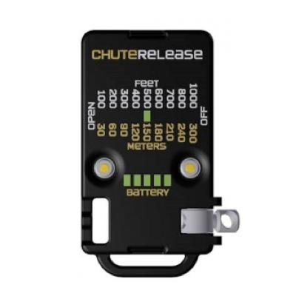
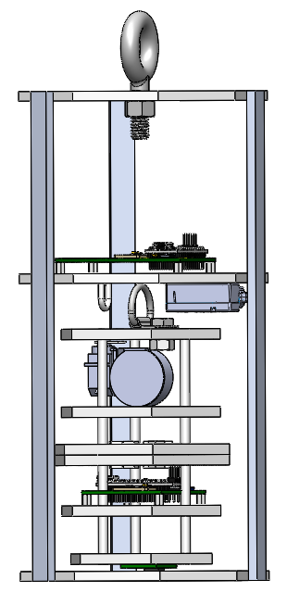
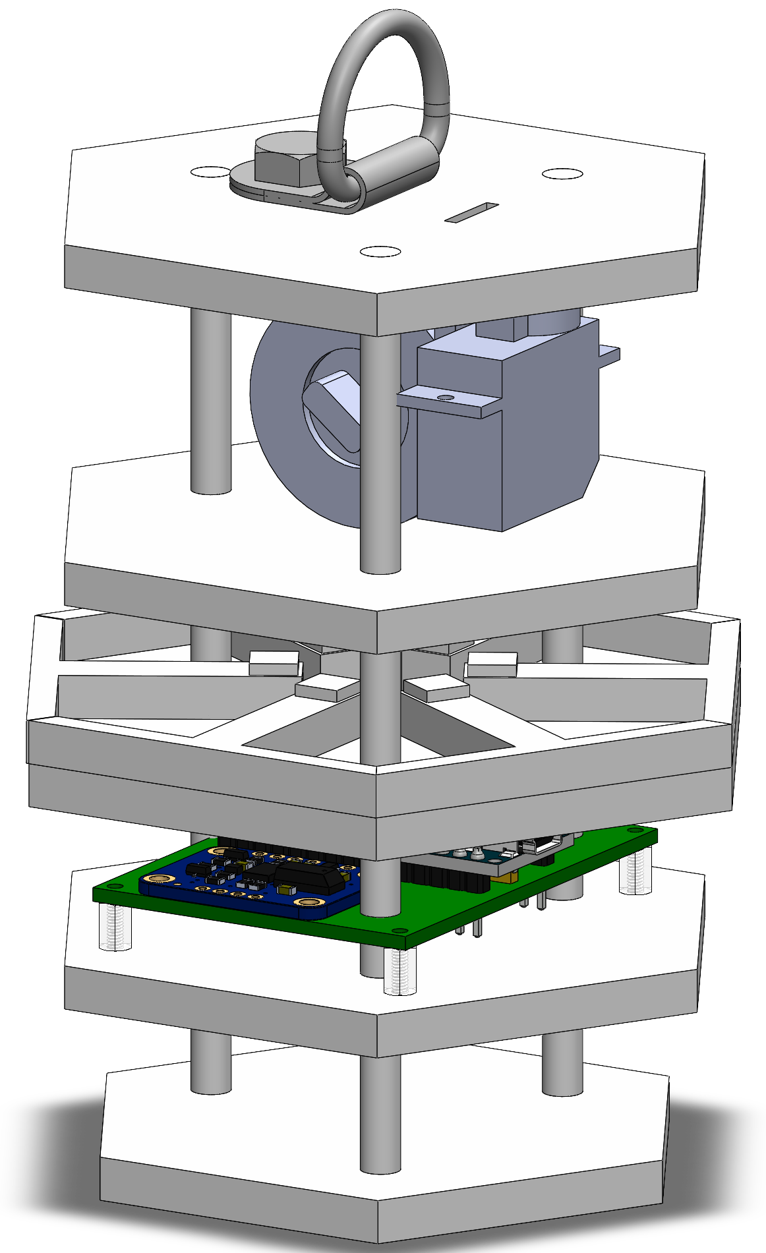
System Level CanSat Configuration Trade & Selection
System Design 1
Tie-down ring for parachute – attached to Altimeter Chute Release
Flag deployment mechanism
Canister avionics bay
Hexagonal payload with deployable heatshield
Presenter: Daniel Horton

Slide 15
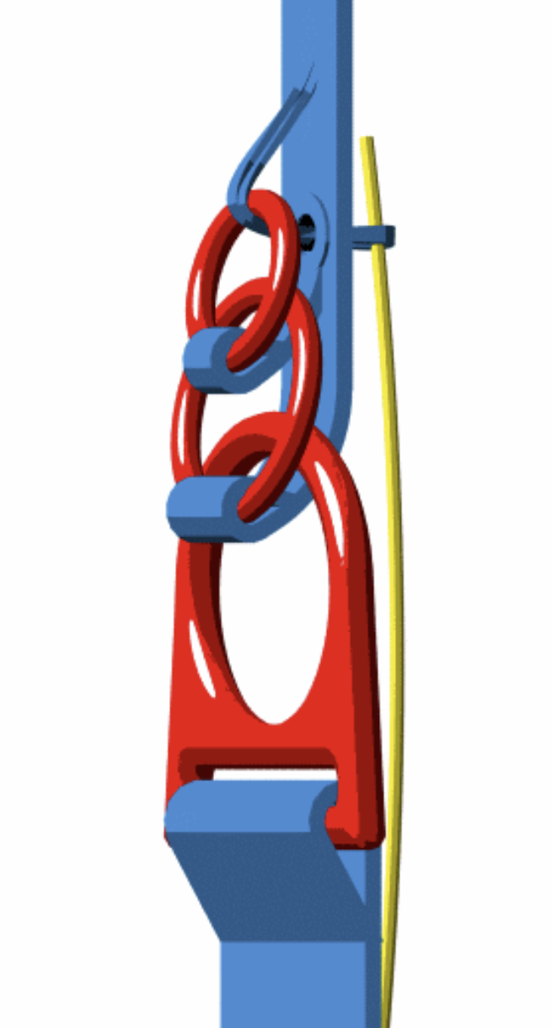
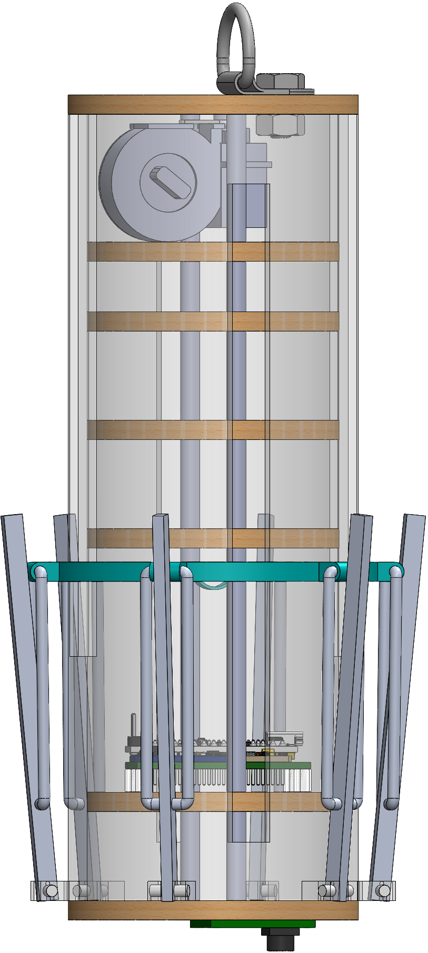
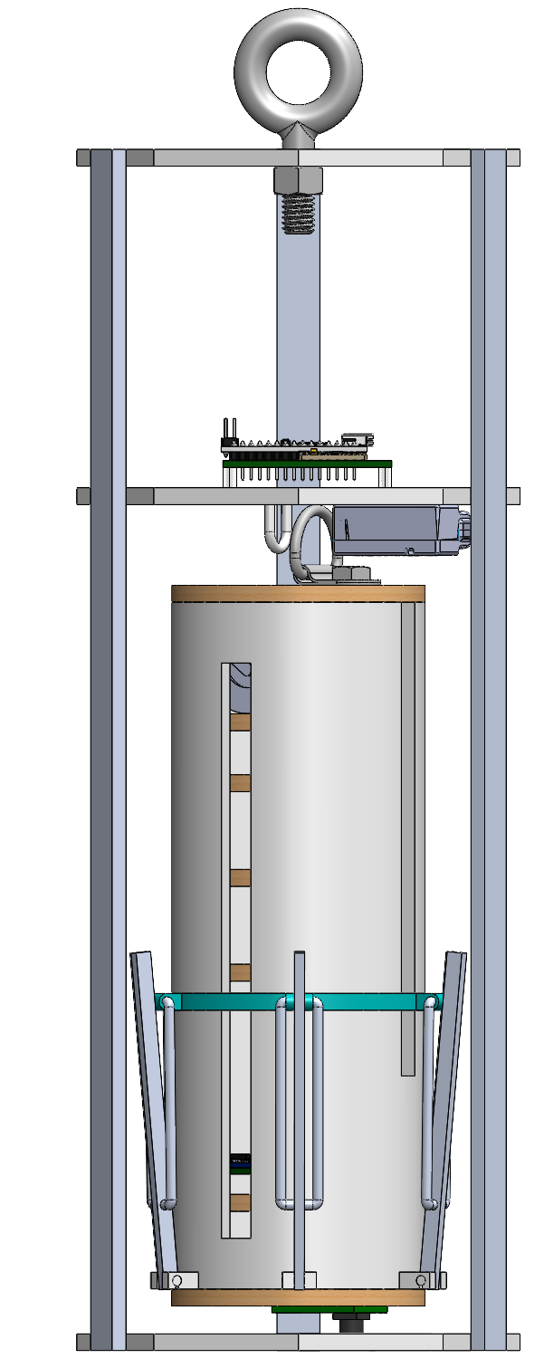
System Level CanSat Configuration Trade & Selection
System Design 2
Tie-down ring for parachute – attached to three-ring release system
Flag deployment mechanism
Canister avionics bay
ABS-enclosed cylindrical payload with deployable heatshield mechanism
Presenter: Daniel Horton

Slide 16
System Level Configuration Selection
Chosen Design: System 1
Configuration | Reasoning
9-sided polygon Canister | Simple to manufacture, light-weight design, composed only of ABS plastic plates, fiberglass eyebolt and aluminum supports fixed together using epoxy.
Hexagonal payload configuration | ABS plates with 6 spring-deployed arms for the aerobraking-heatshield, and aluminum rods supporting the plates. More compact design with fewer unique parts required, making it easier to manufacture.
Altimeter Chute Release | Electronic chute release; does not require any other mechanical components on the payload to deploy the parachute when the desired altitude is reached.
Presenter: Daniel Horton

Slide 17
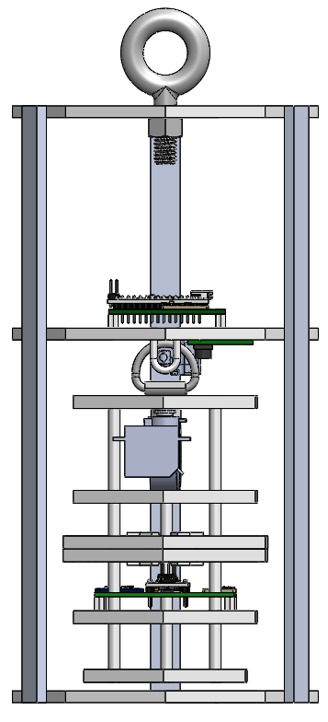
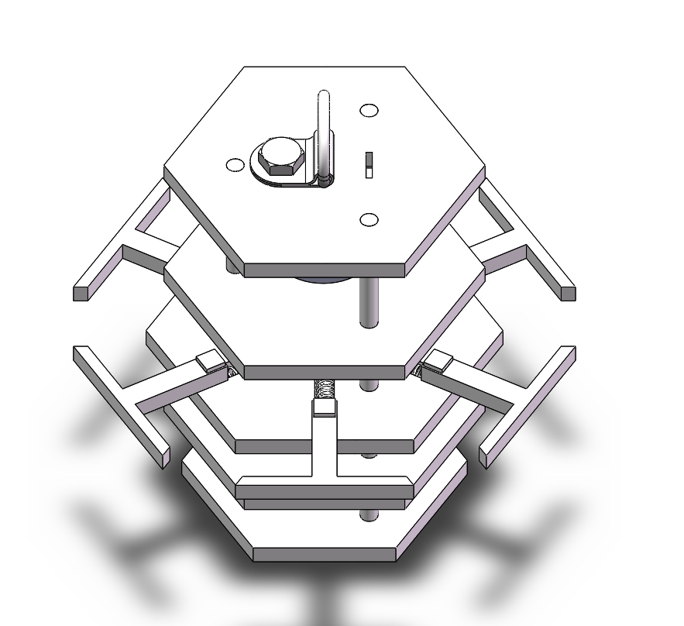
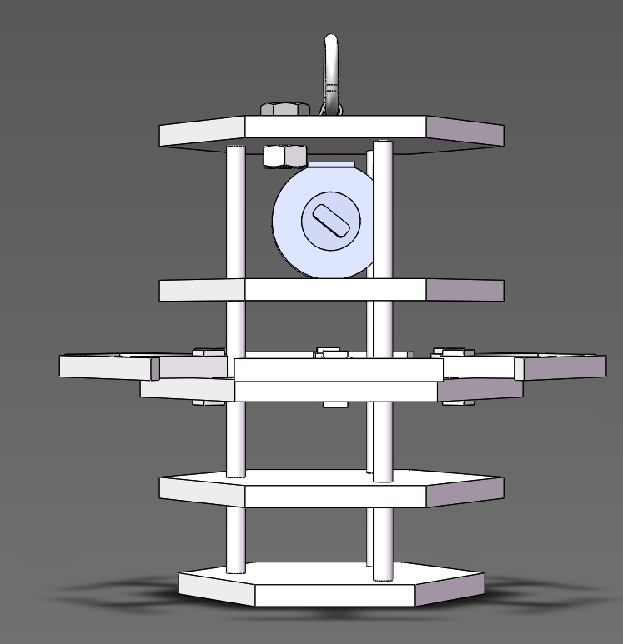
Physical Layout
Launch Configuration
Green- Parachute bay
Blue- Cannister Avionics bay
Yellow- Payload Deployment Assembly
Pink- Payload subassembly
Basic Dimensions
1- 296.45 mm
2- 255.0 mm
3- 154.14 mm
4- 80.0 mm
5- 124.0 mm
1
Payload deployment configuration,
Red lines outline the mylar fabric that will act as the aerobraking heatshield
2
Linear Actuator payload deployment system
3
Flag deployment system
Payload Avionics Bay
Total mass is 681.2 g
4
5
Presenter: Jordi Rey

Slide 18
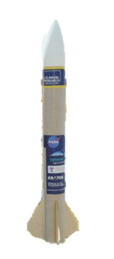

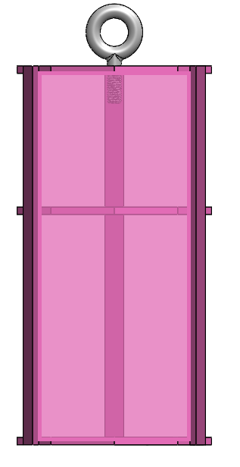
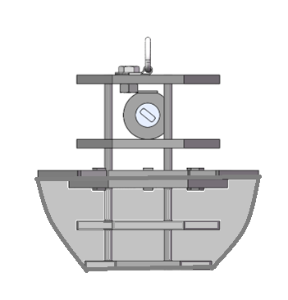
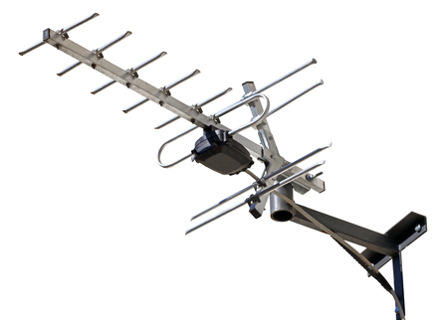


System Concept of Operations
Set up ground station
Power on CanSat
Place CanSat into rocket
Rocket is launched
At 670-725m the CanSat separates and parachute opens
At 400m a probe will be released from the CanSat, which will deploy an aerobraking heat shield, with a camera facing the ground at all times
At 200m the probe will deploy a parachute too reduce descent rate
Probe will land upright
Probe will deploy a flag 500mm above the base of the probe
Recovery crew tracks and collects CanSat
FSW obtains and saves flight data & video recording to thumb drive
5
6
4
7
2
3
1
11
9
8
10
Presenter: Jordi Rey

Slide 19
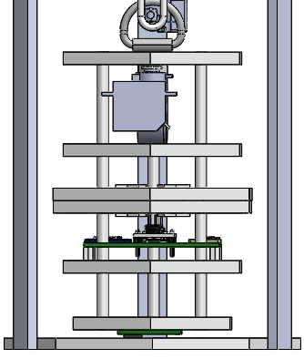
Launch Vehicle Compatibility
Payload Clearance
Sharp edges in this section will be sanded down
0.080 m
NOTE: The first two plates are the same size as the third plate (0.090 m)
0.090 m
0.100 m
0.124 m
Presenter: Jordi Rey

Slide 20
Sensor Subsystem Design
Dylan Falzone

Slide 21
Sensor Subsystem Overview
Sensor Type​ | Model​ | Purpose​ | CanSat Location​
GPS module​ | Adafruit Ultimate | Determine location coordinates (X,Y,Z) & exact time | ​Payload
Pressure Sensor​ | Adafruit BMP280 | Measure altitude of Container & Payload | Container, Payload
Rotational Sensor | BNO055 | Measure gyro readings in degrees per second, angular acceleration, and magnetometer readings in gauss | ​Payload
Temperature Sensor | BNO055 | Measure temperature readings | Payload
Camera​ | Arducam Mini 2MP Plus | View and record Earth’s terrain during descendent | Payload
Presenter: Dylan Falzone

Slide 22
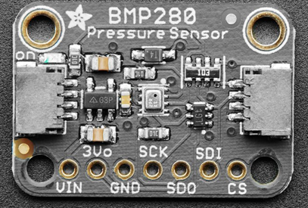
Payload Air Pressure Sensor Trade & Selection
Sensors​ | Current (at 1Hz) (µA)​ | Temperature Range (°C)​ | Interfaces​ | Resolution (hPa)​ | Voltage Usage (V)​ | Size (mm)​ L x W x H​ | Weight (g)​ | Price ($)​
Adafruit MPRLS​ | 3.6​ | -40 to 85​ | I2C, SPI​ | .30 | 1.65 ~ 3.6​ | 17.8 x 16.7 x​ 7.5​ | 1.1 | 14.95​
Adafruit BMP280​ | 2.7​ | -40 to 85​ | I2C, SPI​ | .0016 | 1.71 ~ 3.6​ | 19.2 x 17.9 x 2.9 | 1.3​ | 9.95​
MPL3115A2 | 8.5 | -40 to 85 | I2C | .015 | 1.95~ 3.6 | 18 x 19 x 2 | 1.2 | 9.95
Selection​ | Reasoning for the selection​
Adafruit BMP280​ | - Lower current draw in comparison to . other inspected sensors - Greater resolution in comparison to . other inspected sensors
Presenter: Dylan Falzone
CanSat 2023 PDR: Team 1032 Yes we CANSAT

Slide 23
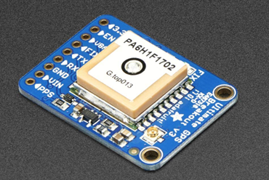
Payload GPS Sensor Trade & Selection
Sensors​ | Update Rate (Hz) | Operating Voltage (V)​ | Current (Tracking) (mA) | Interfaces | Size (mm)​ L x W x H​ | Weight (g)​ | Price ($)​
Adafruit Ultimate Breakout v3​ | 10​ | 3.0 – 5.0 | 20 | I2C, SPI, UART | 25.5 x 35 x 6.5 | 8.5 | 29.95​
uBlox NEO M8N | 10​ | 2.7 – 3.6 | 23 | I2C, SPI, UART | 27.6 x 26.6 x 2.4 | 9.8​ | 11.59​
Titan X1 | 10 | 3.0 – 4.3 | 25 | I2C, SPI, UART | 12.5 x 12.5 6.5 | 4 | 69.84
Selection​ | Reasoning for the selection​
Adafruit Ultimate | - Lower current draw during . tracking in comparison to other . inspected sensors - Previous experience with sensor . and familiarity with Arduino - Availability
Presenter: Dylan Falzone
CanSat 2023 PDR: Team 1032 Yes we CANSAT

Slide 24
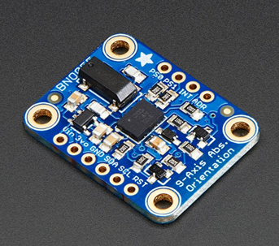
Payload Air Temperature Sensor Trade & Selection
Sensors​ | Temperature Range (°C)​ | Interfaces​ | Voltage Usage (V)​ | Size (mm)​ L x W x H​ | Weight (g)​ | Price ($)​
​HTU31 Temperature & Humidity Sensor | -40 to 125 | I2C​ | 3.3 – 5.5 | 25.5 x 17.7 x​ 4.6 | 1.6​ | 5.95​
BNO055 | -40 to 85​ | I2C or UART | 1.7 – 3.6 | 20 x 27 x 4 | 3 | 34.95
Sensirion SHT31-D | -40 to 125 | I2C​ | 2.4 – 5.5 | 12.7 x 18 x 2.6 | 0.8​ | 13.95​
Selection​ | Reasoning for the selection​
BNO 055 | - Familiarity with sensor - Also meets our requirements for . the payload’s temperature sensor - Availability
Presenter: Dylan Falzone
CanSat 2023 PDR: Team 1032 Yes we CANSAT

Slide 25
Payload Tilt Sensor Trade & Selection
Sensors​ | Temperature Range (°C)​ | Interfaces​ | Voltage Usage (V)​ | Size (mm)​ L x W x H​ | Weight (g)​ | Price ($)​
​HTU31 Temperature & Humidity Sensor | -40 to 125 | I2C​ | 3.3 – 5.5 | 25.5 x 17.7 x​ 4.6 | 1.6​ | 5.95​
BNO055 | -40 to 85​ | I2C or UART | 1.7 – 3.6 | 20 x 27 x 4 | 3 | 34.95
Sensirion SHT31-D | -40 to 125 | I2C​ | 2.4 – 5.5 | 12.7 x 18 x 2.6 | 0.8​ | 13.95​
Selection​ | Reasoning for the selection​
BNO 055 | - Familiarity with sensor - Also meets our requirements for . the payload’s temperature sensor - Availability
Presenter: Dylan Falzone
CanSat 2023 PDR: Team 1032 Yes we CANSAT

Slide 26
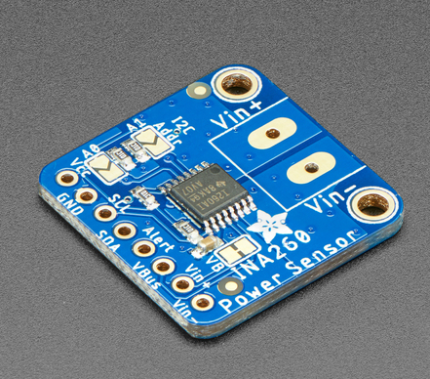
Payload Battery Voltage Sensor Trade & Selection
Sensors​ | Resolution | Interfaces | Size (mm)​ L x W x H​ | Weight (g)​ | Price ($)​
Adafruit INA219 | 12 bit | I2C | 25.6 x 20.4 x 4.7 | 4.6 | 9.95​
Adafruit INA260 | 16 bit | I2C | 22.9 x 22.8 x 2.7 | 2 | 9.95​
Precision LM4040 | 12 bit | I2C | 16 x 12.5 x 2.5 | 0.7 | 7.50
Selection​ | Reasoning for the selection​
Adafruit INA260 | - Greater resolution bit compared to other sensors - Previous experience and familiarity with sensor - Availability
Presenter: Dylan Falzone

Slide 27
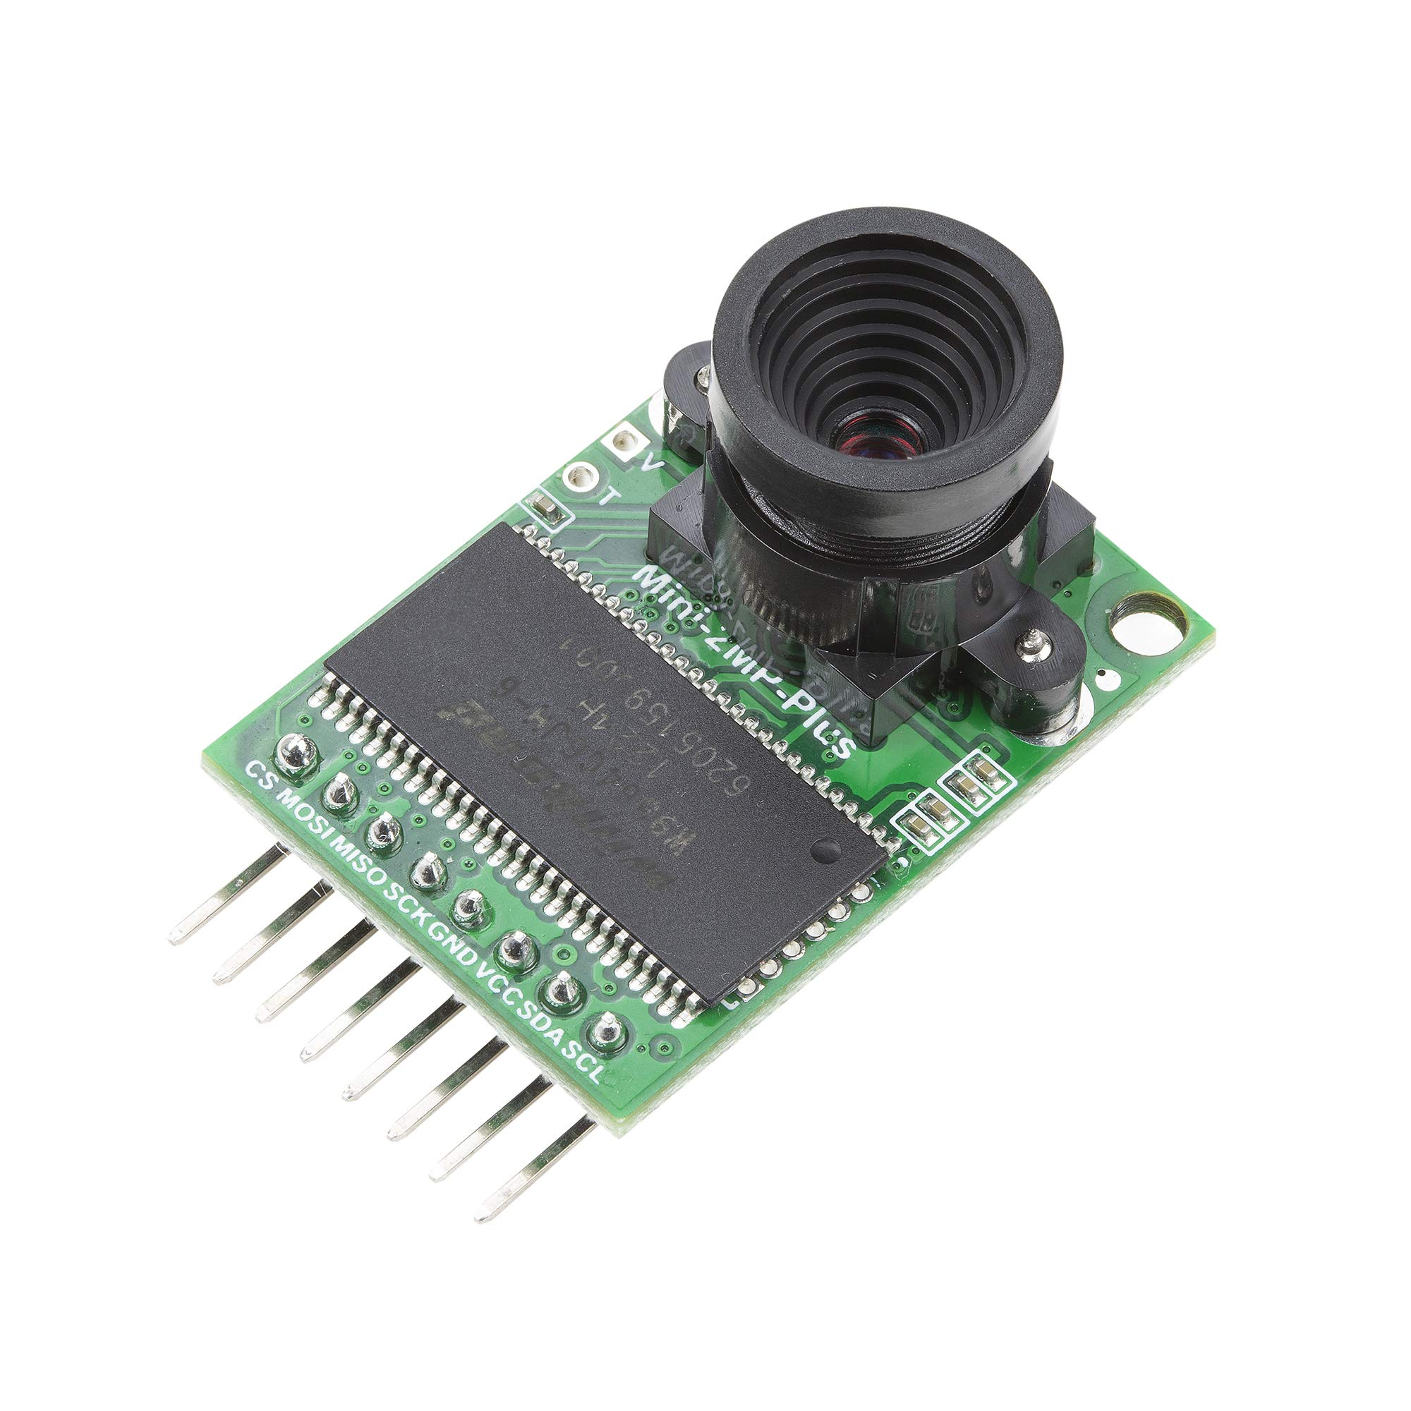
Payload Camera Trade & Selection
Name ​​ | Price ($) ​​ | Weight (g)​​ | Size (mm)​​ | Operating​​ Voltage (V) ​​ | Current Draw (mA) | Framerate (fps)​
Miniature TTL Serial JPEG Camera | 34.95​ | 3​ | 20 x 28 | 3.3 - 5.0​ | 75 | 30​
Arducam Mini 2MP Plus | 25.99 | 20 | 24 x 34 | 3.3 - 5.0 | 20 | 30
Selection​ | Reasoning for the selection​
Arducam Mini 2MP Plus | - Compatibility with microprocessor - Lower current draw in comparison to other inspected sensors
Presenter: Dylan Falzone

Slide 28
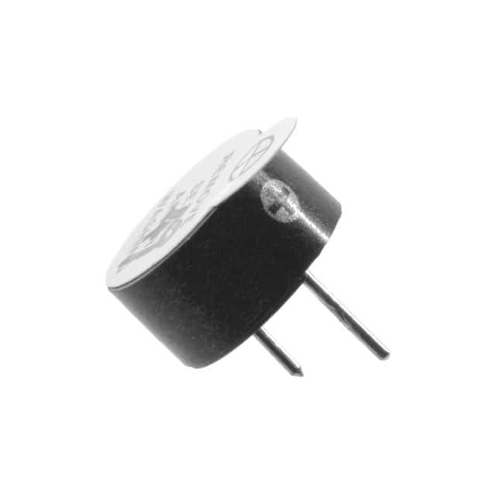
Audio Beacon Trade & Selection
Name ​​ | Min Sound Pressure (dB) | Weight (g)​​ | Operating​​ Voltage (V) ​​ | Mini Current Draw (mA)
PS1240P02BT | 60 | 1 | 3​ | 40
IE092505-1 | 80 | 1 | 5 | 30
Selection​ | Reasoning for the selection​
IE092505-1 | - Compatibility with microprocessor - Meet sound level requirement
Presenter: Dylan Falzone

Slide 29
Bonus Camera Trade and Selection
N/A
Presenter: Dylan Falzone

Slide 30
Descent Control Design
Jovana Markovic, Melissa Gonzalez Grospe

Slide 31
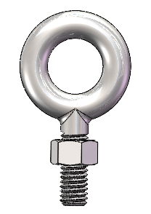
Descent Control Overview (1/3)
Container Descent Control System:
System: Parachute
System Components: Hexagonal Parachute
Parachute Chords
Eyebolt
System Overview: The eyebolt is screwed into the can. The parachute is attached to the eyebolt using chords. The parachute sits atop the can prior to the can’s ejection from the rocket after which the parachute will deploy naturally
Presenter: Jovana Markovic

Slide 32
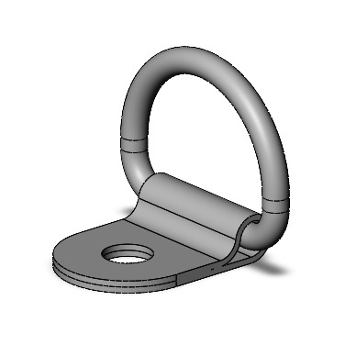
Descent Control Overview (2/3)
Payload Descent Control System:
System: Parachute
System Components: Hexagonal Parachute
Parachute Chords
Altimeter Chute Release
System Overview: The parachute is attached to a tie down ring which is screwed into the payload. The parachute will sit atop the payload held together by the device until the desired altitude is reached, after which the device will release, and the parachute will be allowed to deploy naturally
Presenter: Jovana Markovic

Slide 33
Descent Control Overview (3/3)
Aerobraking:
System: Hexagonal Prism Payload Shape
System Components: Hexagonal Plates
Extendable arms which serve to enlarge one of the plates
Spring system which releases the arms into place
Poles for vertical alignment
System Overview: The spring system will allow for the arm attachments to remain compressed while the payload is within the can. Following deployment from the can, the arms will extend and enlarge the surface area of the central hexagonal plate. The enlarged plate will create a truncated hexagonal pyramid which will increase drag.
Presenter: Jovana Markovic

Slide 34
Container Descent Control Strategy Selection and Trade
Decent Control |  |  | Eyebolt Design |  |  | Tie Down Ring Design
Objective | Weighting Factor | Parameter | Mag. | Score | Value | Mag. | Score | Value
Mass | 0.30 | grams | 10.1 | 9.4 | 2.8 | 15.6 | 6.0 | 1.8
Durability | 0.10 | discussion | good | 8.0 | 0.8 | okay | 6.0 | 0.6
Stability | 0.30 | discussion | great | 10.0 | 3.0 | good | 8.0 | 2.4
Size (Vertical Height) | 0.20 | mm | 66.5 | 3.6 | 0.7 | 23.8 | 10.0 | 2.0
Simplicity | 0.10 | # of parts | 2.0 | 10.0 | 1.0 | 4.0 | 5.0 | 0.5
Overall value |  |  |  |  | 8.3 |  |  | 7.3
Justification: The Eye Bolt design was selected to attach the parachute to the can as it weighs less and requires fewer parts to be installed in comparison to the Tie Down Ring
Configuration A:
Eyebolt
Configuration B:
Tie Down Ring
Presenter: Jovana Markovic

Slide 35
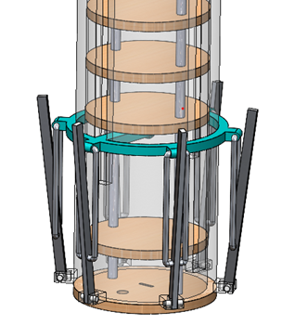
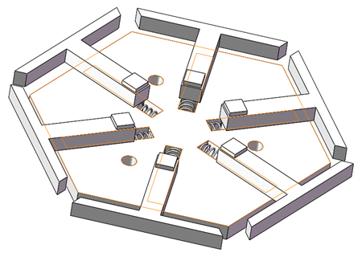
Payload Aerobraking Descent Control Strategy Selection and Trade
Design | Description | Identified Issues | Evaluation
Umbrella Mechanism | Following deployment from the can, six rods will release naturally and extend at an angle in order to create an aerodynamic parabolic shape. | Manufacturing the rods to allow for easy movement proved to be difficult. Lack of storage space for electronics. | Discarded
Spring Loaded Hexagon | Following deployment from the can, a spring system will allow for rods to extend on the top plate of the payload. The top plate will now be larger, which will create a cone shaped payload. | Design is heavier than preferred. The bottom of the payload is a hexagonal plate which may disturb the aerodynamics. | Selected, allows for necessary deceleration while being cheaper and easier to manufacture
Configuration A: Umbrella Mechanism
Configuration B:
Spring Loaded Hexagon
Presenter: Melissa Gonzalez Grospe

Slide 36
Payload Aerobraking Descent Stability Control Strategy Selection and Trade
Method | Description | Identified Issues | Evaluation
Bottom Heavy Payload Design | Designing the payload in a manner in which most of the mechanisms are located towards the center bottom of the payload and distributing the contents of the payload such as the electronics toward the bottom would ensure that the payload lands upright. | Requires extensive testing. Adequate space for the configuration may be an issue. The payload contents may be more susceptible to damage from the shock of deployment in this configuration. | Selected, simple design and preliminary testing has already been completed.
Spinning Payload | The spinning serves the gyroscopically stabilize the payload. | Difficult to implement. The spinning could have a significant effect on the speed at which the payload is descending. | Discarded, impractical
Presenter: Melissa Gonzalez Grospe

Slide 37
Payload Parachute Descent Control Strategy Selection and Trade
Method | Description | Identified Issues | Evaluation
Eyebolt | Consists of a 6.6675 cm long shank which anchors the eye bolt to the payload and a ring at the top which allows for attaching the parachute. Would require an additional nut to hold the eye bolt in place. | Vertical height exceeds allowable value. Would add considerable height to the payload design, possibly requiring modifications to the can design in order to accommodate the height. | Discarded
Tie Down Ring | The tie down ring consists of a D shaped ring which is securely nestled within a base plate. The base plate is folded over and through the ring to secure it. The tie down ring is secured to the payload using an additional nut and screw. | Heavier than preferable. More complex manufacturing compared to eyebolt design. Requires more parts. | Selected, shorter possible shank length saves space, shorter overall height.
Configuration A:
Eyebolt
Configuration B:
Tie Down Ring
Presenter: Melissa Gonzalez Grospe

Slide 38
Descent Rate Estimates (1/2)
Decent Rate Estimates for the following Configurations
Assumptions
~2.7 m/s winds
Total weight is 700 grams
Payload weight is 300 grams
0.53m Hexagon Parachute for Payload
Configuration | Device | Desired Rate | Decent Rate Estimate | Method of Calculation
CanSat with payload | Parachute | 15 ± 5 m/s | 15.3 m/s | Parachute calculations
Payload aerobraking | Umbrella Device | less than 20 m/s | 11.3 ± 3.1 m/s | Drop Testing
Payload parachute released | Parachute | 5 ± 1 m/s | 5.89 ± 1.1 m/s | Drop Testing
Presenter: Melissa Gonzalez Grospe

Slide 39
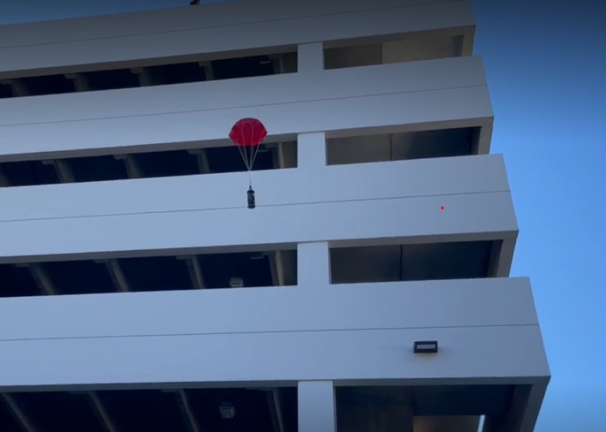
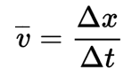
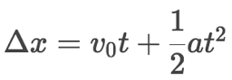
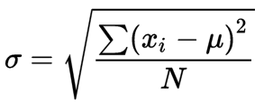
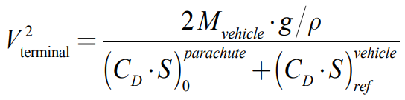
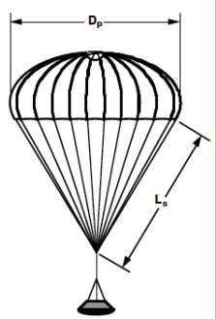
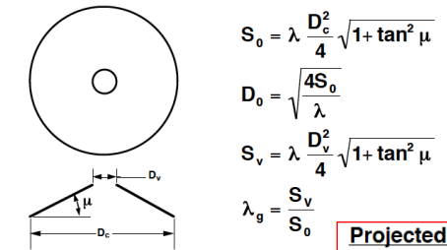
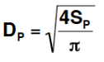

Descent Rate Estimates (2/2)
Testing Information
3D Printed Model of Container and Aerobraking device
Brass weights were used to simulate the weight of the interior components (700 grams & 300 grams)
Parachutes used were those selected from the Trade Study
Prototype was abruptly thrown in an attempt to mimic shock forces incurred at apogee
Each protype was tested 10 times and outliers were removed from each data set
Formulas Used
Formulas Retrieved from:
Section 3.5 Recovery Systems: Parachutes 101 - Utah State University. http://mae-nas.eng.usu.edu/MAE_6530_Web/New_Course/launch_design/Section7.5.pdf.
Presenter: Melissa Gonzalez Grospe

Slide 40
Mechanical Subsystem Design
Daniel Horton, Christian Roque, Savari Datta, Melissa Gonzalez Grospe

Slide 41
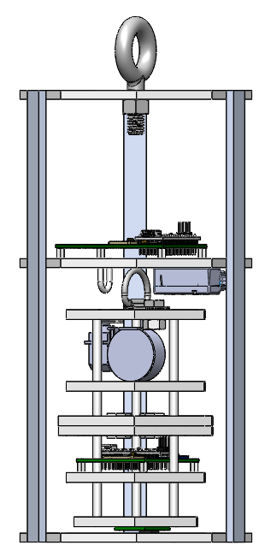
Mechanical Subsystem Overview
Parachute Attachment -
Lightweight fiberglass eyebolt providing mechanical connection between parachute and can.
ABS Platforms -
Nine sided levels add structural support for mounting aluminum rods/supports on the sides, parachute attachment, and electronics.
Aluminum Supports -
Aluminum bar stock fixed to the ABS platforms provides rigid support for the can shape.
Linear Actuator -
Holds the payload inside the container when deployed. Can be retracted to release payload at desired altitude.
Payload Securement Ring -
Used to stop payload from sliding off linear actuator arm.
Flag Deployment – a container will house a clock spring that will be used in reverse to simulate a tape measure that pushes outwards rather than inwards, raising the flag
ABS Nonagon Ring -
Bottom platform is an open nine-sided ring, providing structural support while still allowing the payload to drop through.
Presenter: Daniel Horton

Slide 42
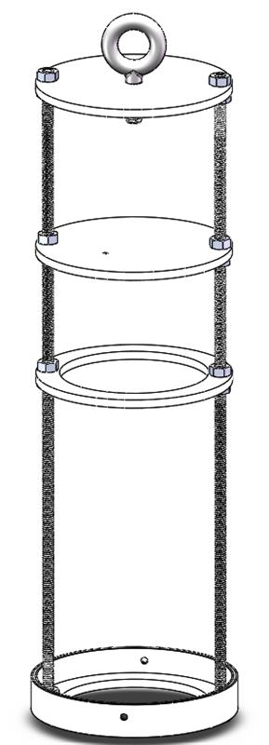
Container Mechanical Layout of Components Trade & Selection (1/2)
Configuration A: Circular Container
Eyebolt
Avionics Bay
ABS Plates
Nut
Aluminum Rod
Design | Description | Materials | Evaluation
Circular Container | Circular shaped container with four levels held together by 2 aluminum rods and 16 corresponding nuts. | Eyebolt (1) – Fiberglass Rod (2) - Aluminum Nut (17) - Aluminum Plates (4) - ABS Plastic | Discarded, not enough space for electrical components and payload to fit
Presenter: Christian Roque

Slide 43
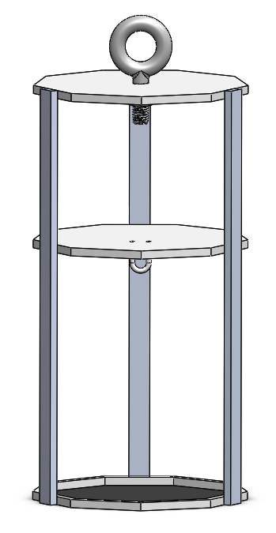
Container Mechanical Layout of Components Trade & Selection (2/2)
Configuration B: Nonagon Container
Eyebolt
Nut
Aluminum Support Rods
Avionics Bay
ABS Plate
Design | Description | Materials | Evaluation
Nonagon Container | Nonagon shaped container with three levels held together by 3 aluminum supports using epoxy. | Eyebolt (1) – Fiberglass Supports (3) – Aluminum Plates (3) - ABS Plastic Nut (1) - Aluminum | Selected, more space on each plate, 3 supports make it structurally intact, less components makes it simpler and much lighter in weight.
Presenter: Christian Roque

Slide 44
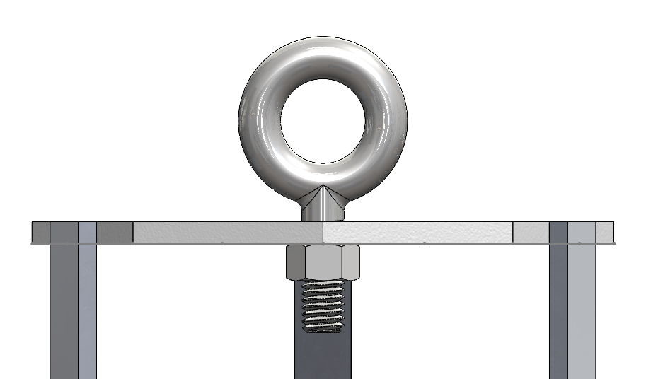
Container Parachute Attachment Mechanism
The parachute for the container will be connected via a fiberglass routing eyebolt that is attached to the top of the container using a nut.
Parachute- folded and placed on top of can within the rocket
Parachute lines
Eyebolt – Serves as the connection between the parachute and the container.
Nut – Tightly secures the Eyebolt to the container.
Presenter: Christian Roque

Slide 45
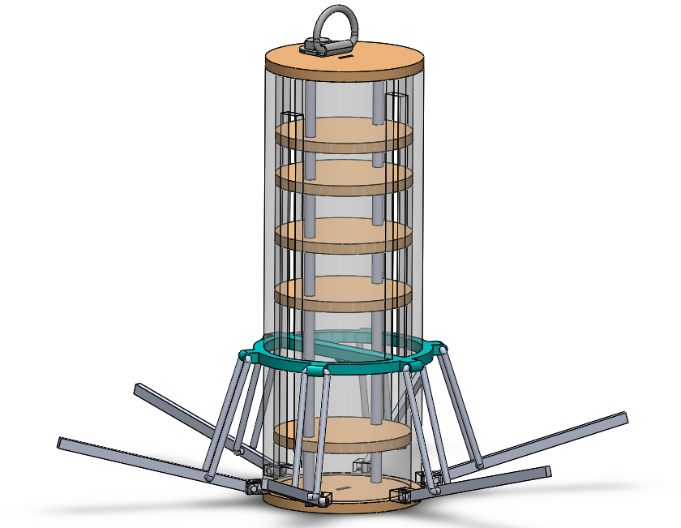
Payload Mechanical Layout of Components Trade & Selection (1/2)
Parachute attachment
Poles
Plates
Avionics Bay
Rods
Pins
NOTE: Payload will be released at 500 meters
Design | Description | Materials | Evaluation
Umbrella Mechanism | Overall cylindrical shape when compacted (in can). When released from can, rods fully extend to create a widened parabolic shape for the bottom half of the payload. All plates are circular. Top 2 plates are used for the parachute attachment and flag deployment device. The rest of the plates that make up the structure of the payload are reserved for electronics. | Plates – Wood Poles – ABS Plastic Rods – Aluminum Pins – ABS Plastic Parachute Attachment – Steel | Discarded
Presenter: Melissa Gonzalez Grospe

Slide 46
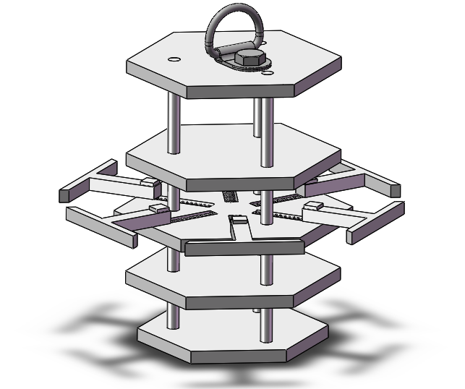
Payload Mechanical Layout of Components Trade & Selection (2/2)
Parachute attachment
Poles
Plates
Springs
Arms
Avionics Bay
Design | Description | Materials | Evaluation
Spring Loaded Hexagon | Overall hexagonal prism shape when compacted (in can). When released from can, arms expand to create an upside down truncated hexagonal pyramid for the bottom half of the payload. All plates are hexagonal. Bottom 2 plates are reserved for electrical components. Top 2 plates are used for the parachute attachment and flag deployment device. | Plates – ABS Plastic Poles – Aluminum Arms – ABS Plastic Springs – Zinc Plated Steel Parachute Attachment – Steel | Selected, easier to manufacture, lighter in weight, structurally practical
Presenter: Melissa Gonzalez Grospe

Slide 47
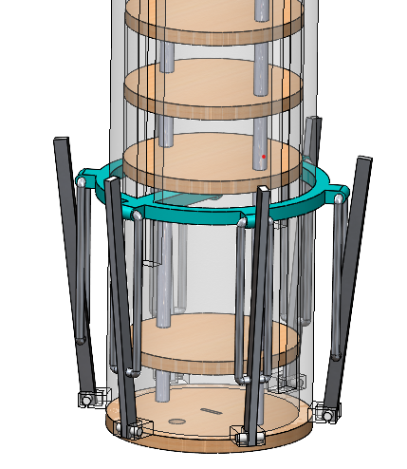
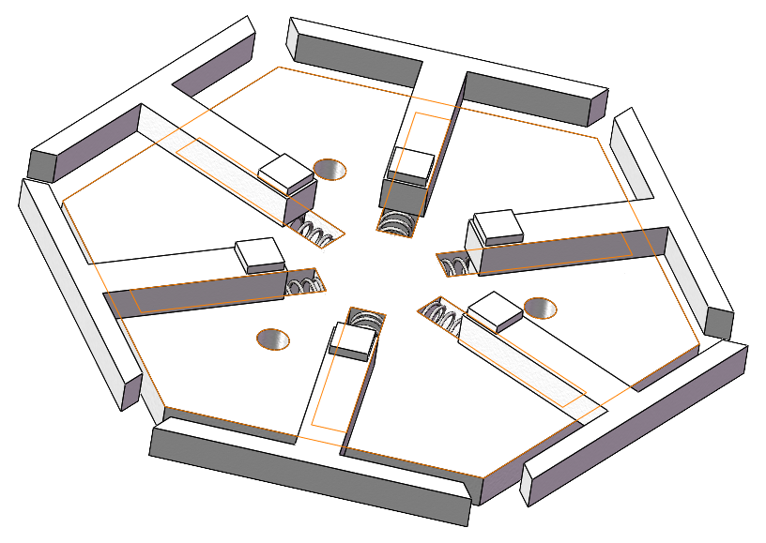
Payload Aerobraking Pre Deployment Configuration Trade & Selection
Configuration A: Umbrella Mechanism
Configuration B: Spring Loaded Mechanism
NOTE: Both designs will be compressed by the interior wall of the container during pre-deployment
Configuration | Advantages | Disadvantages | Evaluation
Umbrella Mechanism | Only uses one spring More secure | Significantly heavier than configuration B Takes up large amount of space Difficult to manufacture | Discarded
Spring Loaded Hexagon | Lightweight Occupies small section of the CanSat Uniform expansion | Large number of components required to hold it in place More friction along the walls of the CanSat | Selected, easier to keep in place
Presenter: Melissa Gonzalez Grospe

Slide 48
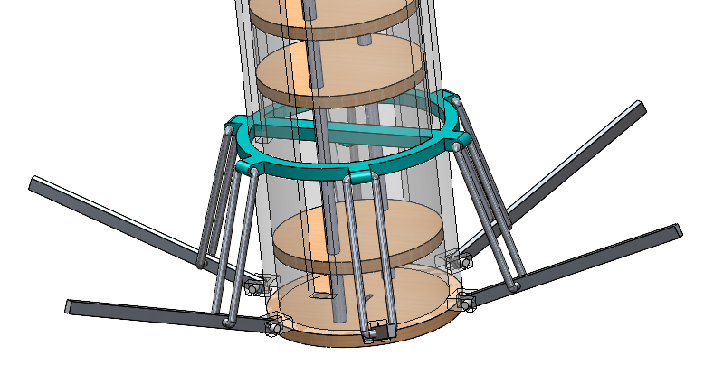
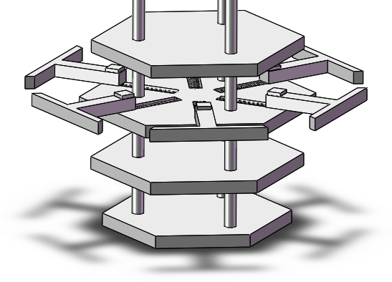

Payload Aerobraking Deployment
Configuration Trade & Selection
Attach Heat Shield material (Mylar) here
Configuration | Method | Identified Issues | Evaluation
Umbrella Mechanism | Upon release from can, the rods will extend fully, causing the implementation of the heat shield which acts as the aerobraking device. This creates an aerodynamic parabolic shape. | Entirely dependent on gravity, difficulty manufacturing the rods | Discarded
Spring Loaded Hexagon | Upon release from can, the spring loaded arms will be expanded, causing the implementation of the heat shield which acts as the aerobraking device. This creates an upside down truncated hexagonal pyramid shape. | Springs could go off inside the can, difficulty assembling the payload and inserting into can | Selected, smaller size makes it easier to deploy. Also, lightweight and easy to manufacture
Presenter: Daniel Horton

Slide 49
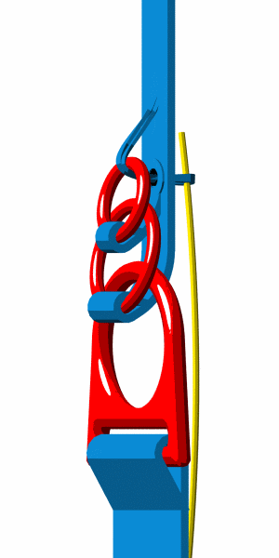
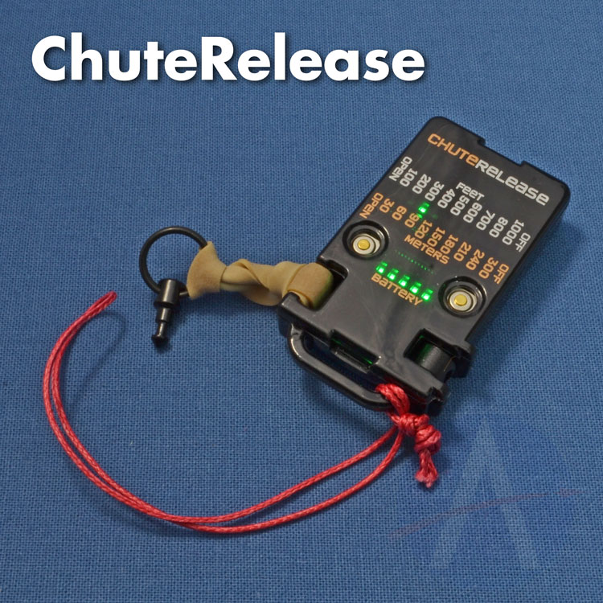
Payload Parachute Deployment
Configuration Trade & Selection
Method | Description | Identified Issues | Evaluation
Three Ring Release System | A cable is passed through this series of loops. Once the payload reaches the desired altitude, the chord will be released in a linear motion using a linear actuator. Releasing the chord will allow the parachute to naturally deploy | Requires a complex mechanical system. Additional linear actuator will add weight to the system. Linear actuator must be able to resist the shock of deployment. Requires extensive testing. | Discarded
Altimeter Chute Release | The parachute will sit atop the payload and be held together by the device using a chord and hook which are attached to the device. Once the desired altitude is reached, the device will release, and the parachute will be allowed to deploy naturally. | Device would add considerable weight to the system. Device would need to be purchased from a third-party and thus add to the expenses. | Selected, easier to secure and implement
Configuration A: Three Ring Release System
Configuration B: Altimeter Chute release
Presenter: Daniel Horton

Slide 50
Payload Uprighting
Configuration Trade & Selection
Method | Benefits | Identified Issues | Evaluation
Active Uprighting System | Much better chance of payload being upright, | Additional subsystem to implement, which would add weight, complexity, and issues with room for all components | Discarded
Passive Uprighting system | Would not require an additional subsystem | Not a guarantee for the payload to land upright, requires extensive testing | Selected, easier to manufacture, less weight added to the system
Presenter: Daniel Horton

Slide 51
Container Mass Budget
Sensor | Quantity | Weight (g) | Source
Adafruit BMP280 | 1 | 1.3 | Actual from Datasheet
Arduino Nano | 1 | 7 | Actual​ from Datasheet
2032 Cell Batteries | 2 | 6.2 (3.1 each) | Actual​ from Datasheet
Aluminum Supports | 3 | 124.9 | Actual from Datasheet
Aluminum Nut | 1 | 0.5 | Actual from Datasheet
Eyebolt | 1 | 2.4 | Actual from Datasheet
Can Platforms | 3 | 140.3 | Estimate
JB Weld Plastic Bonder | 1 | 2 | Estimate
Linear Actuator | 1 | 15 | Actual from Datasheet
Linear Actuator Ring | 1 | 0.2 | Actual from Datasheet
Plastic Coupling Nuts | 4 | 0.4 | Actual from Datasheet
PCB Screws | 4 | 0.1 | Actual from Datasheet
Total Mass: 300.3g
Presenter: Savari Datta

Slide 52
Payload Mass Budget (1/3)
Sensor | Quantity | Weight (g) | Source
Adafruit BMP280 | 1 | 1.3 | Actual​ from Datasheet
BNO-055 | 1 | 3 | Actual​ from Datasheet
Adafruit Ultimate | 1 | 8.5 | Actual​ from Datasheet
Raspberry Pi Pico | 1 | 3 | Actual​ from Datasheet
ANT-900-RP-2-A | 1 | 5 | Estimate
Arducam Mini | 1 | 20 | Actual from Datasheet
Mirco SD cards | 1 | 1 | Actual​ from Datasheet
Micro SD Readers | 1 | 3.4 | Actual​ from Datasheet
XBEE Pro 900 Mhz Radio | 1 | 5 | Actual from Datasheet
2032 Cell Batteries | 2 | 6.2 (3.1 each) | Actual from Datasheet
Presenter: Savari Datta

Slide 53
Payload Mass Budget (2/3)
Sensor | Quantity | Weight (g) | Source
Springs | 6 | 0.3 | Actual from Datasheet
Heatshield Arms | 6 | 14.1 | Estimate
Payload Rods | 3 | 19.5 | Estimate
Platforms | 5 | 138.3 | Estimate
Flag Release | 1 | 6.84 | Estimate
Steel Tape | 1 | 1 | Estimate
Super Lube | 1 | 1 | Estimate
Clock Spring | 1 | 7.8 | Actual from Datasheet
Screw | 1 | 0.7 | Actual from Datasheet
Nut | 1 | 0.5 | Actual from Datasheet
Servo Motor | 1 | 9 | Actual from Datasheet
Presenter: Savari Datta

Slide 54
Payload Mass Budget (3/3)
Sensor | Quantity | Weight (g) | Source
Servo Motor | 1 | 9 | Actual from Datasheet
Mylar Fabric | 1 | 112.1 | Estimate
Parachute | 1 | 28 | Estimate
Total Mass: 380.9 g
Presenter: Savari Datta

Slide 55
Communication and Data Handling (CDH) Subsystem Design
Max Epstein, Yashas Shivaram

Slide 56
Payload Command Data Handler (CDH) Overview
Device Type​​ | Model​​ | Purpose​​
Processor & Memory​ | Raspberry Pi Pico | Facilitate data storage, sensing, communication​
Real-Time Clock​ | Adafruit Ultimate Breakout v3 GPS Module​ | Keep track of times for data & calculation purposes​
Antenna​ | ANT-900-RP-2-A | Transmit/receive data from radio/processor configuration​
Radio​ | XBEE-PRO 900HP | Communicate between antennae & processors​
Presenter: Yashas Shivaram

Slide 57
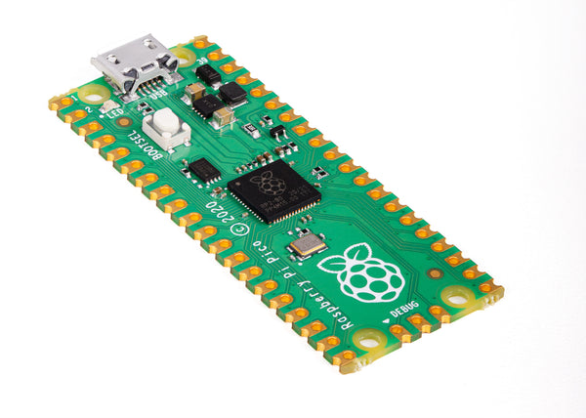
Payload Processor & Memory Trade & Selection
Processor | Boot time(s) | Speed (Mhz) | Memory (KB) | Weight (g) | Dimension (mm) | Voltage Input (V) | Ports
Arduino Nano​ | 8 - 10​ | 16​ | 32​ | 7​ | 18 x 45 ​ | 7 - 12​ | Analog Input - 8 PWM Output - 6 ​ I2C I/O - 1 ​ SPI - 1 ​ DAC Output - 0​
Raspberry pi Pico | 0.5 | 125 | 264 | 3 | 51.3x21 | 1.8 – 5.5 | Analog Input - 4 PWM Output - 8 I2C I/O – 1 SPI – 1 DAC Output - 1
​ Teensy 3.2​ ​ | 5​ | 16​ | 256​ | 4.8 | 18 x 36 | 5​ | Analog Input - 25 ​ PWM Output - 22 I2C I/O - 4 ​ SPI - 3 ​ DAC Output - 2​
Selection​ | Reasoning for selection​
​ Raspberry Pi Pico | - Compact size​ - Compatibility with camera/Familiarity ​ - Availability
Presenter: Yashas Shivaram

Slide 58
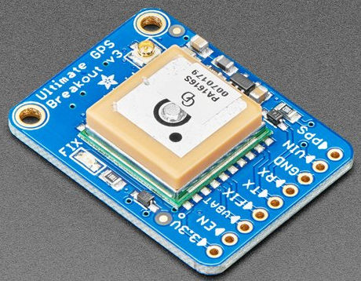
Payload Real-Time Clock
Real-Time Clock Keeper​ | Tolerance Reset​ | Interface | Cost ($)
Microchip MCP7940M-I/P | Real-Time clock continues keeping time in the event of a reset ​ | I2C | 0.75
Arduino Ultimate Breakout v3​ | Real-Time clock continues keeping time in the event of a reset ​ | Internal to GPS | 0.00
Selection​ | Reasoning for selection​
Adafruit Ultimate GPS Breakout | - Already part of the board - GPS Module will have an independent battery backup - No additional weight, size, or circuitry required
Presenter: Yashas Shivaram

Slide 59
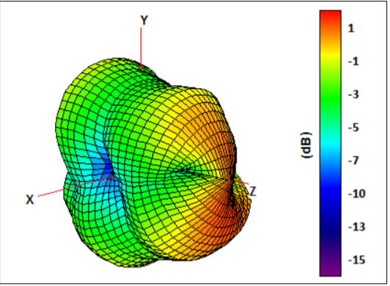
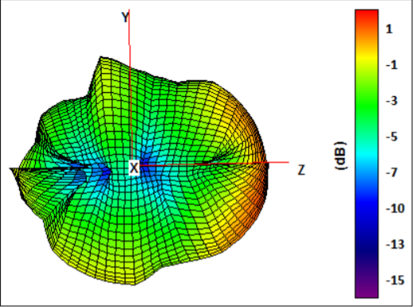
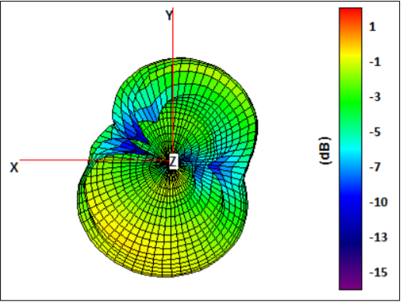
Payload Antenna Trade & Selection
Name​ | Frequency ​ Range (GHz)​ | Length of Antenna (mm)​ | Gain (dBi)​ | Polarization | Connection Type​ | Weight (g)
ANT-900-RP-2-A | ​ .880-.960 | 115 | 2​.1 | (Linear) Vertical | ​SMA​ | 11
Taoglas FXP290 915 MHz | .902-.928 | 100​ | ​1.5 | Linear | ​U.FL | 1.5
Selection​ | Reasoning for selection​
ANT-900-RP-2-A | - In accepted frequency range - Compatible with selected radio - Relatively small size
Presenter: Yashas Shivaram

Slide 60
Payload Radio Configuration
Name​ | Frequency ​ Range (GHz)​ | Outside Range (km) | Antenna Type​ | Weight (g) | Cost ($)
XBEE-PRO 900HP | .902 - .928 | 6.5​ | ​RPSMSA | 6.9 | 68
XBee S2C 802.15.4 | ​2.4 | 1.2​ | ​Wire | 5 | 30
Selection​ | Reasoning for selection​
XBEE-PRO 900HP | - Operates on accepted frequency - Excellent outside range
NETID/PANID – 1032
Transmission Control​
- Data will be continuously sent at 1 Hz during all stages of flight - Transmission will be handled by FSW, starting on power on and ending once the container and payload have landed
Presenter: Yashas Shivaram

Slide 61
Payload Telemetry Format
Transmitted Data will be saved to a .csv file on ground station.
Data Transmitted:
To GCS at 1 Hz packet transmission rate:
Payload sensor readings (Air pressure/temperature, mission time, GPS time, coordinates, power supply voltage, tilt, altitude, and various states)
How is the data formatted?
-Payload-to-GCS:
-<TEAM_ID>,< MISSION_TIME>, <PACKET_COUNT>, <MODE>,
<STATE>, <ALTITUDE>,<HS_DEPLOYED>,<PC_DEPLOYED>,<MAST_RASIED> <TEMP>, <VOLTAGE>, <PRESSURE>,< GPS_TIME>, <GPS_ALTITUDE>, <GPS_LATITUDE>, <GPS_LONGITUDE>, <GPS_SATS>, <TILT_X>,<TILT_Y>, <CMD_ECHO>
Example:
<1063>, <13:35:59>, <25>, <F>, <LAUNCH_WAIT>,<N>,<N>,<N>,<25.3>,<8.3>,<230>, <13:35:35>,<25>,<150.0258>,<168.6765>,<58>,<5.02>,<3.05><CXON>
Presenter: Max Epstein

Slide 62
Payload Telemetry Format
Telemetry Field​ | Purpose​​ | Relayed From:​
<TEAM_ID>​ | Team ID number (1063)​ | Payload
<MISSION_TIME>​ | UTC time from RST=0 in 1st software state (hh:mm:ss)​
<PACKET_COUNT>​​ | # of packets transmitted across all devices​
<MODE>​ | 'F' = Flight (default) mode, 'S' = Simulation mode​
<STATE>​ | Software State (STARTUP, DESCENT, etc.)​
<ALTITUDE>​ | Altitude in meters relative to ground level​ (+/- 0.1 m)
<HS_DEPLOAYED>​ | ‘P’ if the probe has been deployed, ‘N’ if not
<PC_DEPLOAYED>​ | ‘C’ if the probe parachute has been deployed, ‘N’ if not
<MAST_RAISED>​ | ‘M’ if the flag has been raised, ‘N’ if not
<TEMP>​ | The temperature in degrees Celsius (+/- 0.1C)
Presenter: Max Epstein
CanSat 2023 PDR: Team 1032 Yes we CANSAT

Slide 63
Payload Telemetry Format
Telemetry Field​ | Purpose​​ | Relayed From:​
<PRESSURE>​ | The air pressure in kPa (+/- 0.1 kPa) | Payload
<VOLTAGE>​ | Voltage reading of Container power bus​ (+/- 0.1 V)
<GPS_TIME>​ | UTC time generated from GPS (hh:mm:ss)​ (+/- 1 sec)
<GPS_LATITUDE>​ | GPS latitude coordinate in decimal degrees​ (+/- 0.0001 degrees North)
<GPS_LONGITUDE>​ | GPS longitude coordinate in decimal degrees​ (+/- 0.0001 degrees West)
<GPS_ALTITUDE>​​ | GPS altitude coordinate in decimal degrees​ (+/- 0.1 m from sea level)
<GPS_SATS>​ | # of satellites being tracked by GPS​
<TILT_X>​ | The angle of the payload in the x direction in degrees (+/- 0.01)
<TILT_Y>​ | The angle of the payload in the y direction in degrees (+/- 0.01)
<CMD_ECHO>​ | The last command received and processed by the payload
Presenter: Max Epstein
CanSat 2023 PDR: Team 1032 Yes we CANSAT

Slide 64
Payload Command Formats
CX - Container Telemetry On/Off Command
CMD,<TEAM_ID>, CX, <ON_OFF>
CMD & CX | Static Text
<TEAM_ID> | Assigned Team Identification
<ON_OFF> | ON-activates Container transmissions OFF- turns off transmissions
Example: CMD,1032,CX,ON
ST - Set Time
CMD,<TEAM_ID>, ST, <UTC_TIME>
CMD & ST | Static Text
<TEAM_ID> | Assigned Team Identification
<UTC_TIME> | UTC time in the format hh:mm:ss
Example: CMD,1032,ST,13:35:59
SIMP - Simulated Pressure Data
CMD,<TEAM_ID>, SIMP, <PRESSURE>
CMD & SIMP | Static Text
<TEAM_ID> | Assigned Team Identification
<PRESSURE> | simulated atmospheric pressure data in units of pascals with a resolution of one Pascal.
Example: CMD,1032,SIMP,101325
SIM - Simulation Mode Control Command
CMD,<TEAM_ID>, SIM, <MODE>
CMD & SIM | Static Text
<TEAM_ID> | Assigned Team Identification
<MODE> | ‘ENABLE’ to enable -‘ACTIVATE’ to activate-'DISABLE’ both disables and deactivates -> simulation mode.
Example: CMD,1032,SIM,ACTIVATE
Presenter: Max Epstein

Slide 65
Electrical Power Subsystem (EPS) Design
Paolo D’Alessandro

Slide 66
EPS Overview
3.3V Battery
3.3V Battery
Switch
5V Regulator
3.3V Regulator
5V Bus
3.3V Bus
Presenter: Paolo D’Alessandro

Slide 67
Payload Electrical Block Diagram
Power (6.6V Battery)
Switch
5V Regulator
3.3V Regulator
Raspberry Pi Pico (Powered by USB from Computer during Testing)
On/Off LED
IE92505 Speaker (5V)
MicroSD Reader (5V, SPI)
BNO055 (5V, I2C)
Arducam Mini 2MP Plus (3.3V, I2C)
BMP280 (5V, SPI)
Adafruit Ultimate Breakout (5V, USART)
XBEE Pro 900HP (5V, SPI)
Presenter: Paolo D’Alessandro

Slide 68
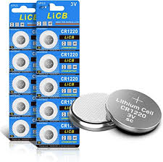
Payload Power Trade & Selection
Type | Battery | Voltage | Capacity | Weight | Qty. Needed | Total Voltage | Total Weight
Alkaline Industrial Battery | 9V | 9V | 3.6mAh | 46g | 1 | 9V | 46g
Lithium LiCB | CR2032 | 3.3V | 236mAh | 3.1g | 2 | 6.6V | 6.2g
Selection | Reason for Selection
Lithium LiCB CR2032 | - Smaller weight and easily scalable for more power
Battery Configuration
Two CR2032 in series to provide ~6V
Presenter: Paolo D’Alessandro

Slide 69
Payload Power Budget
Component​ | Voltage (V)​ | Power per Unit (W)​ | Duty Cycle (%)​ | Power Consumption (Wh)​ | Source
Raspberry Pi Pico (Microcontroller)​ | 9V​ | .1406​ | 100​ | 0.1406 | Datasheet
Adafruit Ultimate Breakout (GPS)​ | 5V​ | .1​ | 100​ | .1​ | Datasheet
BMP280​ (Air Temperature/Pressure)​ | 5V​ | 0.00025 | 100​ | 0.000025 | Datasheet
IE092505-1 (Sound Alert) | 5V​ | .03​ | 100​ | 50m​ | Datasheet
Xbee Pro 900 HP​ (Radio Module)​ | 5V​ | .0.95 | 100​ | .95​ | Datasheet
LED Light (Lighting Alert) | 2.2V | 0.044 | 100 | 0.044 | Datasheet
BNO 055 (Temp/Rotational Sensor) | 1.7-3.6V | 0.0123 | 100 | 0.00155 | Datasheet
Presenter: Paolo D’Alessandro

Slide 70
Flight Software (FSW) Design
Max Epstein

Slide 71
FSW Overview (1/2)
Flowchart
Start communication between payload and GCS
Process live altitude data
Boot up
Calibrate Sensors
Detect payload landing
Start payload parachute release
Terminate
telemetry
Start
Payload release
Raise Mast
Initiate audio beacon
Presenter: Max Epstein

Slide 72
FSW Overview (2/2)
Programming Languages | Python
Development Environments | Visual Studio Code
FSW Tasks | - Boot up and collect sensor data in the correct units required by CanSat. - Communicate telemetry from the payload and container to the GCS to store data. - Keep track of altitude and release the payload and parachute when needed. - Trigger audio beacon after landing.
Payload FSW | - Payload communication - In charge of collecting data with sensors - Contains temperature sensor, pressure sensor, rotational sensor, camera
Presenter: Max Epstein

Slide 73

Payload FSW State Diagram (1/3)
Presenter: Max Epstein

Slide 74

Payload FSW State Diagram (2/3)
Presenter: Max Epstein

Slide 75

Payload FSW State Diagram (3/3)
Presenter: Max Epstein

Slide 76
Payload FSW State Diagram
FSW Recovery from Reset
What is used to recover:
Mission Time
GPS Time
Software State
Altitude
Causes that call for reset:
Power loss (power supply)
Physical damage
Processor failure
Presenter: Max Epstein

Slide 77
Simulation Mode Software
Sensor changes
All air pressure sensors disabled
Simulation mode commands
<MODE> switches from 'F' (Flight) to 'S' (Simulation)
How is simulated sensor data substituted with real data?
External data from text file fed into certain fields instead of air pressure sensor readings
<ALTITUDE>, <PRESSURE>
All other sensor readings & telemetry remain the same
Presenter: Max Epstein

Slide 78
Software Development Plan (1/2)
Prototyping and Prototyping Environments
Environment in Visual Studio Code and Arduino IDE
Modular code parts
Development Team
Max Epstein
Dylan Falzone
Yashas Shivaram
Paolo D’Alessandro
Test Methodology
Simulation mode with varying datasets.
Freefall sensor testing
Presenter: Max Epstein

Slide 79
Software Development Plan (2/2)
Subsystem​ | Development Sequence​
Sensors​ | Sensor trade and selection compare and select the best Program each individual sensor in Arduino Integrate and conglomerate all programs, make sure it still functions
Xbee Radio​ | Configure and test point to point communication for the radio (controller and GCS port)​ Integrate sensors with Xbee for data transmission
Flight Control​ | Program feedback system with servos connected to flight mechanisms​
Release Mechanisms​ | Program release mechanisms such as linear actuators​
Software State​ | Use the data from sensors to change the states
Audio Beacon​ | Program locator audio beacon​
Integration​ | Integrate all software subsystem and ensure 1Hz data transmission from payload. Also, to make sure the software states match up with what is occurring.
Presenter: Max Epstein

Slide 80
Ground Control System (GCS) Design
Dylan Falzone, Max Epstein

Slide 81




GCS Overview
Flight Software
Presenter: Dylan Falzone

Slide 82



GCS Design
Specifications​
Laptop Battery | 4 Hours
Overheating Mitigation | Umbrella & Laptop Cooler
Auto update Mitigation | Disable Auto-Update
Presenter: Dylan Falzone

Slide 83


GCS Antenna Trade & Selection
Name​ | Frequency ​ Range (GHz)​ | Length of Antenna (mm)​ | Gain (dBi)​ | Polarization | Connection Type​ | Weight (g) | Cost ($)
Right-Angle Mini GSM | .85-2.1 | 57​ | ​2​ | (Linear) Vertical | Right Angle SMA | 8 | 4.95
TL-Dipole Swivel Antenna | ​2.4 | 200​ | 5​ | (Linear) Vertical | RP-​SMA​ | 30 | 8.95
900 MHz 14 dBi Al Yagi Antenna | .90-.928 | 1422 | 14 | Linear | N-Female | 680 | 72.32
Selection​ | Reasoning for selection​
Yagi Antenna | - Gain strength immensely stronger than the other antennas - Larger antenna - Ideal frequency range - Handheld, easy to maneuver
Presenter: Dylan Falzone

Slide 84
GCS Software (1/3)
Software Packages:
• Python 3.9.7 - Computational environment of choice
• XCTU – XBee Program Software
• XBEE Python Library – real time access to XBEE via USB interface
• Matplotlib Python Library – real time plotting and data manipulation
• PySimpleGUI Python Library – visual design layout and manipulation
• Pandas Python Library – real time data collection and .csv file status
Command Software and Interface:
• Commands can be sent from the Ground Control Station to the CanSat via command.
• The GCS uses the XBEE Python Library to access the XBEE receiver through the USB interface.
Telemetry Data Recording:
• Telemetry will be saved in a .csv file without manipulation after being read via USB interface.
• .csv data will be analyzed in python and presented via GUI and saved in file.
CSV File Generation:
• .csv file will be generated in GCS Python software for payload and data will be continuously added to the created file as it arrives in packets to GCS.
Presenter: Max Epstein

Slide 85

GCS Software (2/3)
Presenter: Max Epstein

Slide 86

GCS Software (3/3)
Presenter: Max Epstein

Slide 87
CanSat Integration and Test
Jordi Rey, Yashas Shivaram

Slide 88
CanSat Integration and Test Overview
CanSat Integration and Test Overview
Subsystem Level Test Plan
Integrated Level Functional Test Plan
Environmental Test Plan
Simulation Test Plan
Presenter: Yashas Shivaram

Slide 89
Subsystem Level Testing Plan (1/2)
Subsystem Level Testing​
Sensors​ | - Pressure sensor tests - Temperature sensor tests - GPS location & time tests​ - Rotational Sensors tests - Camera recording and saving video tests
CDH​ | - Processor clock speed tests​ - EEPROM storage size tests​ - EEPROM read/write speed tests​
EPS​ | - Battery voltage readings​ - Impedance tests on each component​ - Battery power output & tolerance tests​
Radio Communications | - XBEE radio receiver/sender tests - Antenna signal quality tests - Packet receival and transmission tests
Presenter: Yashas Shivaram

Slide 90
Subsystem Level Testing Plan (2/2)
Subsystem Level Testing​
FSW​ | - Data live graph generation tests - Simulation mode tests - CSV data saving & handling - Software states testing
Mechanical​ | - Container & probe structural tests - Probe deployment tests - Probe upright testing - Avionics bay structural integrity tests - Parachute deployment release tests - Probe stability control tests - Flag raising test
Descent Control​ | - Parachute Drogue tests - Parachute reefing tests - Parachute deployment tests - Aerobraking device testing
Presenter: Yashas Shivaram

Slide 91
Integrated Level Functional Test Plan
Testing Plan
Decent Testing | - PID Controller payload descent rate tests
Communications | - Telemetry transmission and retrieval tests - Communication between GCS and Payload
Mechanisms | - Payload release mechanism tests - Payload stability control tests - Aerobrake release mechanism tests - Flag deployment mechanism tests - Payload parachute release mechanism tests
Deployment | - Payload deployment tests are various altitudes - Payload parachute deployments tests at various altitudes - Aerobrake deployments tests are various altitudes - Linear actuator integration with altitude sensor readings
Presenter: Jordi Rey

Slide 92
Environmental Test Plan (1/2)
Drop Test​
Verify that all structures can survive 15 Gs of launch acceleration and 30 Gs of shock​
Thermal Test
Verify the CanSat can operate in a hot environment without materials and/or components becoming functionally compromised​
Vibration Test
Verify the structural integrity of all mounts and connections within the CanSat​
Verify that the container can survive deployment from rocket​
Verify that payload remains in stowed state
Verify that component and battery mounts can withstand applied forces
Verify that payload remains in stowed state
Fit Check
Verify that the CanSat and container fits within rocket to minimize deployment failure
Vacuum Test
Verify deployment operations of the payload
Presenter: Jordi Rey

Slide 93
Environmental Test Plan (2/2)
Drop Test
Thermal Test
Vibration Test
Fit Check
Vacuum Test
Plan: Secure the CanSat to testing rig with non-stretch cord, release the CanSat from 61 cm and allow it to freefall, inspect CanSat and payloads for damage, if there was no damage then run a functional test.
Plan: Place the CanSat in an insulating cooler with a hair dryer, use a remote thermometer to monitor temperature, turn on the CanSat, turn off the heat source once internal temperatures reach 60C and turn on heat sources when temperature reaches 55C. Main this for 2 hours. With heat source off, visually inspect and functionally test CanSat to verify operational integrity survived thermal exposure​.
Plan: Attach the CanSat to a random orbital sander and power it up to full speed, wait 5 seconds after the sander is at full speed then power it off, repeat the process 5 more times. Remove CanSat from fixture and visually inspect and functionally test CanSat to verify operation integrity. Verify accelerometer data is still being collected.
Plan: Construct a prototype of the rocket cylinder wall, place the container with the payloads properly stowed inside of the prototype and check for proper fit as well as the ability to securely deploy.
Plan: Construct a vacuum chamber using a bucket and a vacuum cleaner. Suspend fully configured and powered CanSat within the vacuum chamber and turn on the vacuum. Monitor telemetry and stop the vacuum once peak altitude has been reached. Let air enter vacuum chamber slowly and monitor operation of CanSat. Collect and save telemetry. Save telemetry for judge reviewal.
Presenter: Jordi Rey

Slide 94
Simulation Test Plan
How simulation works
After configuration, once the SIM ENABLE and SIM ACTIVATE commands are ran, simulation mode will run.
The ground station will transmit pressure data from a csv file at 1Hz intervals to the payload.
What parts are tested
The configuration and echoing of commands.
The flight software will determine altitude using radio linked values instead of live sensor data.
The flight software will detect the launch and release payload and parachute at respective altitudes.
Lastly, the mast will be raised and the audio beacon will begin once landing is detected
The deployment of payload parachute, mast raise, and trigger of audio beacon.
The calculation of altitude with fed data from the CSV.
Payload video is saved and pointing in the correct direction.
Presenter: Jordi Rey

Slide 95
Mission Operations & Analysis
Jordi Rey

Slide 96

Overview of Mission Sequence of Events (1/2)
Flowchart
Presenter: Jordi Rey

Slide 97
Overview of Mission Sequence of Events (2/2)
Roles & Responsibilities
• Mission Control Officer – Savari Datta
• Ground Station Crew – Christian Roque, Max Epstein, and Yashas Shivaram
• Recovery Crew – Jordi Rey and Daniel Horton
• CanSat Crew – Paolo D'Alessandro, Jovana Markovic, Melissa Gonzalez Grospe, Dylan Falzone, Savari Datta, Jordi Rey
Antenna Construction & Ground System Setup
• Handheld ground station antenna will be mounted to wood to be easily handled and aimed before competition date
• Ground system will be setup by Ground Station Crew, this includes the adapters necessary for the ground station antenna and XBEE radio
Presenter: Jordi Rey

Slide 98
Mission Operations Manual Development Plan
Mission Operations Manual Outline:​
CGS Configuration:
Indicates the status of the GCS, antennas, and flight software for final pre-flight checks.
CanSat Preparation and Assembly:
Indicates the assembly of the CanSat, damage inspection, and assembly of components
CanSat-Rocket Integration:
Indicates a final checklist and procedure for rocket clearances and assembly inspections.
Launch Preparation:​
Provided by CanSat competition.​
Launch Procedure:​
Provided by CanSat competition.​
Removal Procedure:​
Provided by CanSat competition.
Presenter: Jordi Rey

Slide 99
CanSat Location and Recovery
Recovery Crew will be responsible for container and payload recovery
Container & Parachute will be a bright pink color making them easier to identify and locate.
Most recently logged position on GPS will be used to more accurately locate the payload
Contact information and return address labels will be on both the container and the payload
Presenter: Jordi Rey

Slide 100
Requirements Compliance
Savari Datta

Slide 101
Requirements Compliance Overview
Yes we CANSAT’s project complies with the requirements of the CanSat 2023 mission
The requirement compliance was measure using three conditions which are detailed below: Full Compliance, Partial Compliance, and No Compliance.
Full Compliance​ | The CanSat project complies 50/61 mission requirements
Partial​ Compliance | There are 8 requirements partially satisfied by our CanSat. This means that the requirement is technically met but will require further analysis and testing for finalization. The mass will meet requirements after the addition of the “No Compliance” components
No Compliance | There are 3 requirements our current build does not comply to. Modifications are currently being planned out to add access to the switch and wrap everything so it is secure
Presenter: Savari Datta

Slide 102
Requirements Compliance
Req # | Description​ | Comply / No Comply / Partial | X-Ref Slide(s) Demonstrating Compliance | Team comments or notes
1​ | Total mass of the CanSat (science payloads and container) shall be 700 grams +/- 10 grams. | Partial | 17 | Additional Components to be added
2​ | CanSat shall fit in a cylindrical envelope of 125 mm diameter x 400 mm length. Tolerances are to be included to facilitate container deployment from the rocket fairing. | Comply | 17
3​ | The container shall not have any sharp edges to cause it to get stuck in the rocket payload section which is made of cardboard. | Comply | 19 | Sides will be sanded
4​ | The container shall be a fluorescent color; pink, red or orange. | Comply | 44, 99
5​ | The container shall be solid and fully enclose the science probes. Small holes to allow access to turn on the science probes are allowed. The end of the container where the probe deploys may be open. | No comply |  | To be added
6​ | The rocket airframe shall not be used to restrain any deployable parts of the CanSat. | Comply | 41
7​ | The rocket airframe shall not be used as part of the CanSat operations. | Comply | 41
8​ | The container’s parachute shall not be enclosed in the container structure. It shall be external and attached to the container so that it opens immediately when deployed from the rocket. | Comply | 44
9​ | The Parachutes shall be fluorescent Pink or Orange | Comply | 99
10​ | The descent rate of the CanSat (container and science probe) shall be 15 meters/second +/- 5m/s. | Comply | 38
Presenter: Savari Datta

Slide 103
Requirements Compliance
Req # | Description​ | Comply / No Comply / Partial | X-Ref Slide(s) Demonstrating Compliance | Team comments or notes
11​ | 0 altitude reference shall be at the launch pad. | Comply | 85
12 | All structures shall be built to survive 15 Gs of launch acceleration. | Comply | 39 | Needs Testing
13 | All structures shall be built to survive 30 Gs of shock | Comply | 39 | Needs Testing
14 | All electronics and mechanical components shall be hard mounted using proper mounts such as standoffs, screws, or high-performance adhesives. | Comply | 41-46
15 | All mechanisms shall be capable of maintaining their configuration or states under all forces. | No Comply | 39 | Needs Testing
16 | Mechanisms shall not use pyrotechnics or chemicals. | Comply | 41
17 | Mechanisms that use heat (e.g., nichrome wire) shall not be exposed to the outside environment to reduce potential risk of setting vegetation on fire. | Comply | 41
18 | Both the container and payload shall be labeled with team contact information including email address. | Comply | 99
19 | Cost of the CanSat shall be under $1000. Ground support and analysis tools are not included in the cost. Equipment from previous years should be included in this cost, based on current market value. | Comply | 51-55
20 | XBEE radios shall be used for telemetry. 2.4 GHz Series radios are allowed. 900 MHz XBEE radios are also allowed. | Comply | 60
21 | XBEE radios shall have their NETID/PANID set to their team number. | Comply | 60
Presenter: Savari Datta
CanSat 2023 PDR: Team 1032 Yes we CANSAT

Slide 104
Requirements Compliance
Req # | Description​ | Comply / No Comply / Partial | X-Ref Slide(s) Demonstrating Compliance | Team comments or notes
22 | XBEE radios shall not use broadcast mode. | Comply | 60
23 | The container and probe shall include an easily accessible power switch that can be accessed without disassembling the CanSat and science probes and in the stowed configuration. | Partial | 67,68
24 | The probe shall include a power indicator such as an LED or sound generating device that can be easily seen or heard without disassembling the CanSat and in the stowed state. | Comply | 67
25 | An audio beacon is required for the probe. It shall be powered after landing. | Comply | 67, 75
26 | The audio beacon shall have a minimum sound pressure level of 92 dB, unobstructed. | Partial | 28 | Mid-implementation
27 | Battery source may be alkaline, Ni-Cad, Ni-MH or Lithium. Lithium polymer batteries are not allowed. Lithium cells must be manufactured with a metal package similar to 18650 cells. Coin cells are allowed. | Comply | 68
28 | An easily accessible battery compartment shall be included allowing batteries to be installed or removed in less than a minute and not require a total disassembly of the CanSat. | Partial | 17 | Mid-implementation
29 | Spring contacts shall not be used for making electrical connections to batteries. Shock forces can cause momentary disconnects. | Comply | 81-89
30 | The Cansat shall operate during the environmental tests laid out in Section 3.5. | Comply | 93
31 | The Cansat shall operate for a minimum of two hours when integrated into the rocket. | Comply | 58
32 | The probe shall be released from the container when the CanSat reaches 500 meters. | Comply | 45
Presenter: Savari Datta
CanSat 2023 PDR: Team 1032 Yes we CANSAT

Slide 105
Requirements Compliance
Req # | Description​ | Comply / No Comply / Partial | X-Ref Slide(s) Demonstrating Compliance | Team comments or notes
33 | The probe shall deploy a heat shield after leaving the container. | Comply | 47-48
34 | The heat shield shall be used as an aerobrake and limit the descent rate to 20 m/s or less. | Comply | 31, 35-34
35 | At 200 meters, the probe shall release a parachute to reduce the descent rate to 5 m/s +/- 1m/sec. | Comply | 49, 38
36 | Once landed, the probe shall upright itself. | Partial | 50 | No active uprighting
37 | After uprighting, the probe shall deploy a flag 500 mm above the base of the probe when the probe is in the upright position. | Comply | 41
38 | The probe shall transmit telemetry once per second. | Comply | 60, 75, 92
39 | The probe telemetry shall include altitude, air pressure, temperature, battery voltage, probe tilt angles, command echo, and GPS coordinates that include latitude, longitude, altitude and number of satellites tracked. | Comply | 61
40 | The probe shall include a video camera pointing down to the ground. | Comply | 28
41 | The video camera shall record the flight of the probe from release to landing. | Comply | 28
42 | The video camera shall record video in color and with a minimum resolution of 640x480. | Comply | 28
44 | The flight software shall maintain a count of packets transmitted which shall increment with each packet transmission throughout the mission. The value shall be maintained through processor resets | Comply | 61
45 | The probe shall maintain mission time throughout the whole mission even with processor resets or momentary power loss. | Comply | 61
Presenter: Savari Datta
CanSat 2023 PDR: Team 1032 Yes we CANSAT

Slide 106
Requirements Compliance
Req # | Description​ | Comply / No Comply / Partial | X-Ref Slide(s) Demonstrating Compliance | Team comments or notes
46 | The probe shall have its time set to within one second UTC time prior to launch. | Comply | 64
47 | The probe flight software shall support simulated flight mode where the ground station sends air pressure values at a one second interval using a provided flight profile csv file. | No Comply |  | To be added
48 | In simulation mode, the flight software shall use the radio uplink pressure values in place of the pressure sensor for determining the container altitude. | No Comply |  | To be added
49 | The container flight software shall only enter simulation mode after it receives the SIMULATION ENABLE and SIMULATION ACTIVATE commands. | Comply | 63, 65, 94
50​ | The ground station shall command the CanSat to start calibrating the altitude to zero when the CanSat is on the launch pad prior to launch. | Comply | 64
51​ | The ground station shall generate csv files of all sensor data as specified in the Telemetry Requirements section. | Comply | 86
52​ | Telemetry shall include mission time with 0.01 second or better resolution. | Comply | 61
53​ | Configuration states such as zero altitude calibration shall be maintained in the event of a processor reset during launch and mission. | Comply | 73
54​ | Each team shall develop their own ground station. | Comply | 81
55 | All telemetry shall be displayed in real time during descent on the ground station. | Comply | 85
56 | All telemetry shall be displayed in engineering units (meters, meters/sec, Celsius, etc.) | Comply | 85
Presenter: Savari Datta
CanSat 2023 PDR: Team 1032 Yes we CANSAT

Slide 107
Requirements Compliance
Req # | Description​ | Comply / No Comply / Partial | X-Ref Slide(s) Demonstrating Compliance | Team comments or notes
57​ | Teams shall plot each telemetry data field in real time during flight. | Comply | 85
58​ | The ground station shall include one laptop computer with a minimum of two hours of battery operation, XBEE radio and a hand-held antenna. | Comply | 81
59​ | The ground station must be portable so the team can be positioned at the ground station operation site along the flight line. AC power will not be available at the ground station operation site | Comply | 81
60​ | The ground station software shall be able to command the container to operate in simulation mode by sending two commands, SIMULATION ENABLE and SIMULATION ACTIVATE. | Comply | 84, 94
61 | When in simulation mode, the ground station shall transmit pressure data from a csv file provided by the competition at a 1 Hz interval to the cansat. | Comply | 84, 94
Presenter: Savari Datta
CanSat 2023 PDR: Team 1032 Yes we CANSAT

Slide 108
Management
Savari Datta

Slide 109
CanSat Budget – Hardware (1/2)
Component​ | Quantity​ | Unit Price ($)​ | Total Price ($)​ | Value Type​
Adafruit BMP280 | 2​ | 9.95 | 19.90 | Actual​
BNO-055 | 1​ | 34.95 | 34.95​ | Actual​
Adafruit Ultimate | 1 | 29.95​ | 29.95 | Actual​
Raspberry Pi Pico | 1​ | 4.50​ | 4.50​ | Actual​
ANT-900-RP-2-A | 1​ | 3.99​ | 3.99​ | Actual​
Arducam Mini | 1 | 25.99​ | 25.99 | Actual​
Mirco SD cards | 1​ | 4.20​ | 4.20​ | Actual​
Micro SD Readers | 1 | 8.00 | 8.00​ | Actual​
XBEE Pro 900 Mhz Radio | 1 | 68.25​ | 68.25 | Actual​
2032 Cell Batteries | 4​ | 1.20 | 4.80​ | Actual​
Arduino Nano | 1 | 20.70 | 20.70 | Actual
ABS Filament 1.75mm ABS, 1 kg | 1 | 22.99 | 22.99 | Actual
Springs | 6 | 2.32 | 13.92 | Actual
Tie Down Ring | 1 | 1.24 | 1.24 | Actual
Presenter: Savari Datta

Slide 110
CanSat Budget – Hardware (2/2)
Component​ | Quantity​ | Unit Price ($)​ | Total Price ($)​ | Value Type​
Linear Actuator | 1 | 65.00 | 65.00 | Actual
Servo Motor | 1 | 8.84 | 8.84 | Actual
¼-20 Hex Nut | 2 | 9.81 | 9.81 | Actual
Steel Tape | 1 | 14.99 | 14.99 | Actual
Super Lube | 1 | 7.39 | 7.39 | Actual
Clock Spring | 1 | 8.38 | 8.38 | Actual
JB Weld Plastic Bonder | 1 | 15.74 | 15.74 | Actual
Fiberglass Eyebolt | 1 | 5.66 | 5.66 | Actual
Aluminum Poles | 1 | 5.00 | 5.00 | Estimate
¼ -20 Screw | 1 | 13.84 | 13.84 | Actual
Mylar Reflective Material | 1 | 26.00 | 26.00 | Actual
Aluminum Strip | 1 | 6.93 | 6.93 | Actual
Parachutes | 2 | 17.95 | 35.90 | Actual
Plastic Coupling Nuts | 4 | 5.55 | 22.20 | Actual
PCB Screws | 4 | 1.25 | 5.00 | Actual
Presenter: Savari Datta

Slide 111
CanSat Budget – Other Costs (1/2)
Component​ | Quantity​ | Unit Price ($)​ | Total Price ($)​ | Value Type​
Ground Station​ | -​ | -​ | -​ | -​
Xbee USB Shield​ | 1​ | 26.00​ | 26.00​ | Actual​
900 MHz 14 dBi Al Yagi Antenna | 1​ | 72.32​ | 72.32 | Actual​
900 MHz XBEE Radio | 1​ | 68.25 | 68.25 | Actual​
Laptop​ | 1​ | 1​ | 0​ | Provided by Team Member​
Prototyping ​ | 1​ | 1​ | 150.00​ | Estimate​
Test Supplies​ | 1​ | 1​ | 150.00​ | Estimate​
Test Facilities/​ Manufacturing Equipment​ | 1​ | 1​ | 0​ | Covered by University​
Presenter: Savari Datta

Slide 112
CanSat Budget – Other Costs (2/2)
Source of Income:​ | Funds Provided ($):​
UF MAE Department​ | 4000.00​
Hardware Costs:​ | $514.06
Other Costs:​ | $466.57
Competition Fees: | $200.00
Total Costs:​ | $1180.63​
A total cost of $1057.09 for the testing and building of our CanSat as well as CanSat related fees leaves us with a total of $2819.37 for travel, housing, and food expense. This is expected to be more than sufficient for our 10 members.
Presenter: Savari Datta

Slide 113

Program Schedule Overview
The schedule below is a broad overlook of the 2022-2023 completion schedule for our team
The key below defines symbols for the more detailed schedule
KEY
Design Phase Overview | Important Action
Task | Holiday/Vacation
Presenter: Savari Datta

Slide 114

Detailed Program Schedule (1/2)
Presenter: Savari Datta

Slide 115

Detailed Program Schedule (2/2)
Presenter: Savari Datta

Slide 116
Conclusions
Major Accomplishments
All electronics have been purchased and ordered Parachute testing has been conducted Payload subsystem has run preliminary testing Majority of telemetry components programmed Avionics communication and data handling in progress Significant funding secured
Major Unfinished Work
Prototype of CanSat Telemetry communication tests between payload, container, and Ground Station Manufactured container and payload Definitive plan to enclose container and payload
Justification for Next Stage
Major goals for each subsystem outlined and in progress Testing on descent has started Full team engaged and dedicated to success
Presenter: Savari Datta

